Slide 1
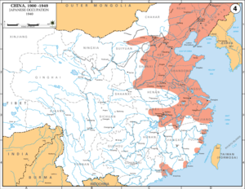
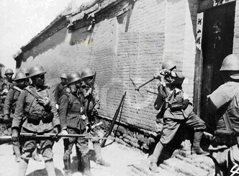
How did the Japanese invasion help strengthen the Communists?
L/O – To examine the role of the Japanese Invasion (1931-1945) in helping the CCP achieve power

Slide 2
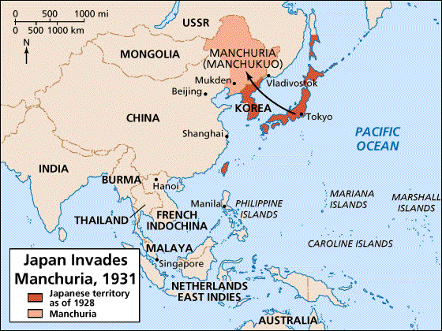
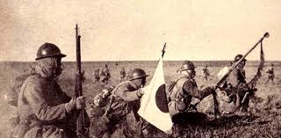
The Japanese Invasion of Manchuria
In 1931, the Japanese invaded the northern province of Manchuria. They renamed it Manchukuo. Chiang did little to stop them. He was preoccupied with the threat from the CCP.
He actually ordered troops not to resist, fearing a full-scale invasion of China.

Slide 3
Disease of the Soul?
“The Japanese are a disease of the skin, it can be cured. The Communists are a disease of the soul; it affects the whole body.”
Chiang Kai-Shek, speaking in 1936
People were furious that he hadn’t stood up to Japanese aggression. Chiang believed that national unity had to be achieved before attacking the Japanese.
In 1936 he ordered another extermination campaign against the CCP in their new base at Yanan.
Look at the above source. In your own words, explain what Chiang means.

Slide 4
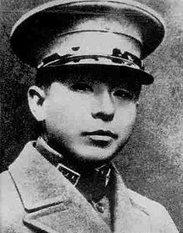
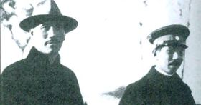
The Rise of Zhang Xueliang
However KMT troops, commanded by Zhang Xueliang the warlord of Manchuria, refused to fight the Communists.
In 1936, Zhang made an agreement with the CCP not to fight each other. Chiang was furious.

Slide 5
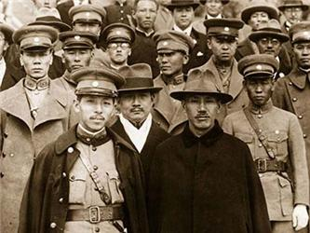
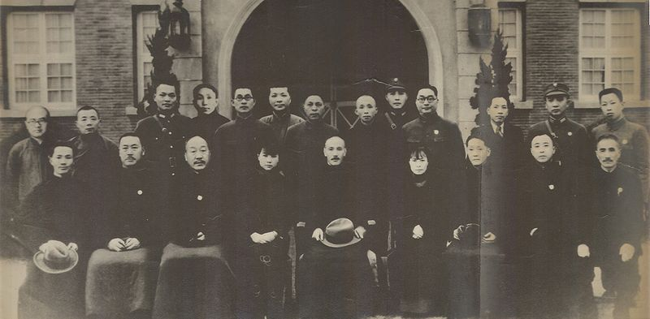
The Xi’an Incident & United Front
Chiang opposed the agreement but in December 1936 he was kidnapped at Xian by Zhang’s troops and kept prisoner for 2 weeks.
He was eventually released when he agreed to form a 2nd United Front with the CCP against Japan.
The Russians government agreed to give military aid.

Slide 7
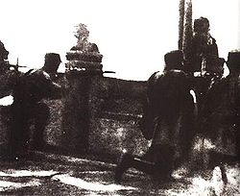
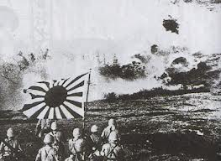
The Japanese Invasion of China
Despite the United Front, the well-equipped, modern Japanese armies swept south into the rest of China.
In July 1937, Japanese troops attacked Chinese troops at the Marco Polo Bridge, near Peking.
This was the start of a full scale war which lasted until 1945.

Slide 8
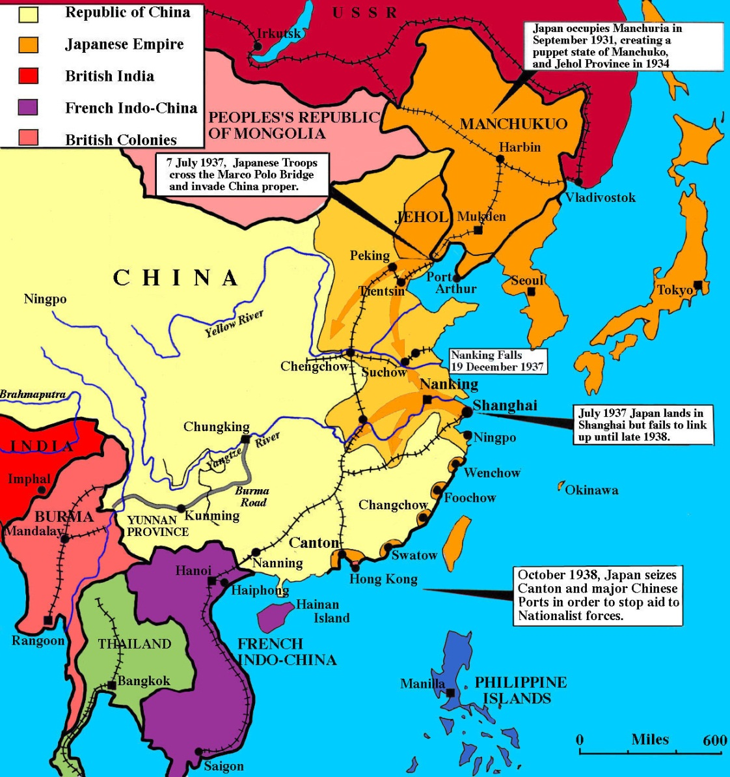

Slide 9
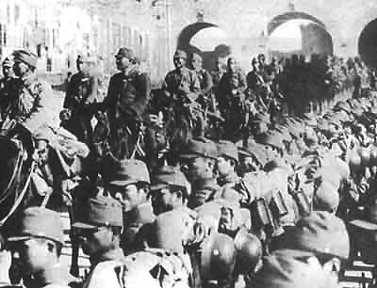
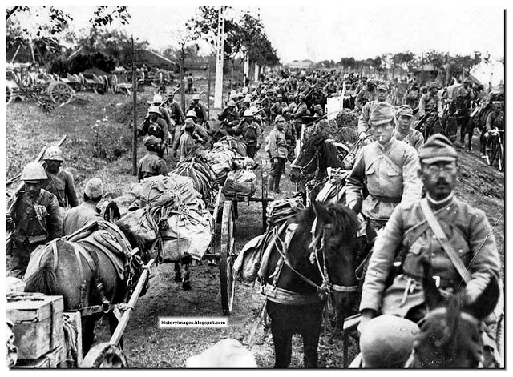
Chiang retreats to Sichuan
By the start of 1938 there were 1 million Japanese troops in China and by the end of the year Japan had occupied many of China’s ports, industry and commercial centres.
Chiang and the KMT retreated to the mountains of Sichuan province. By the start of WW2 in 1939, China had been virtually conquered.

Slide 10
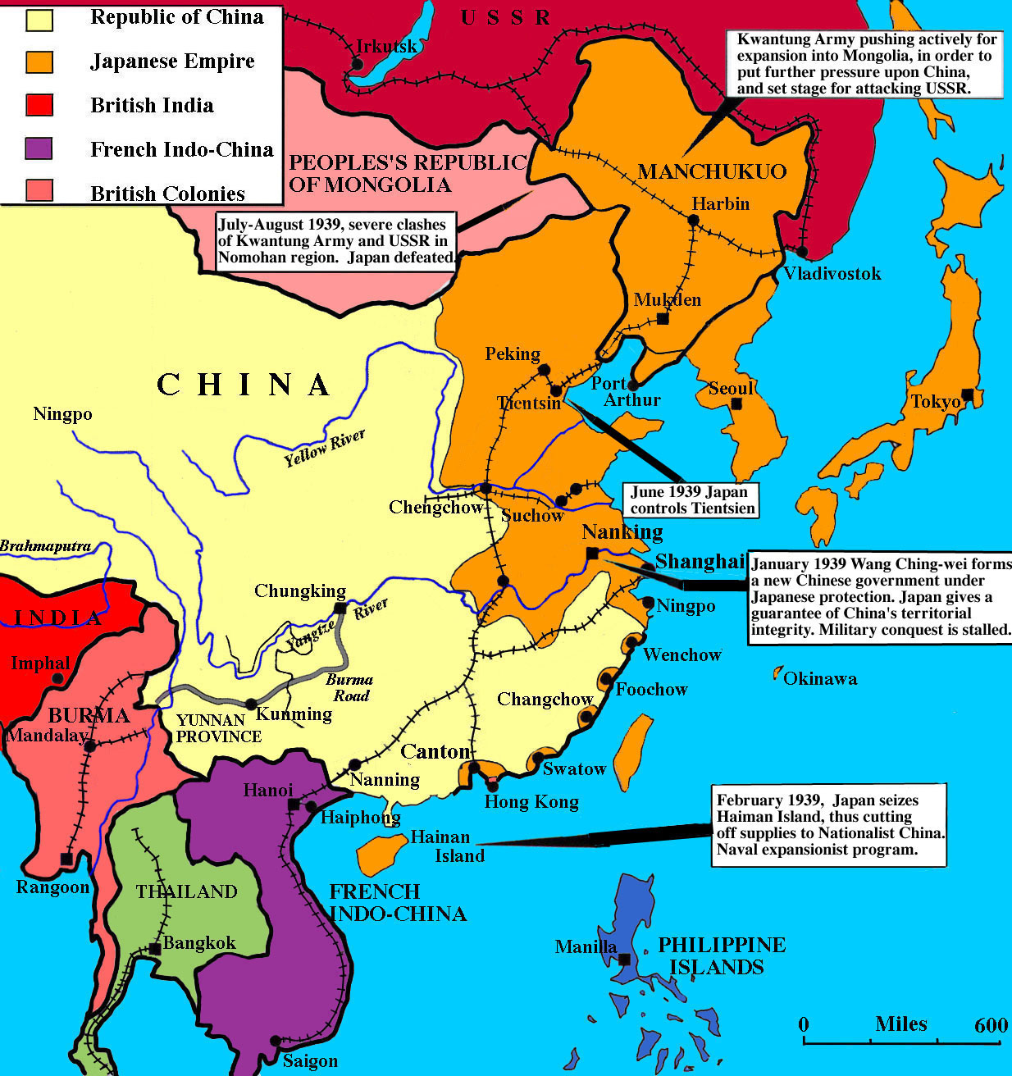

Slide 11
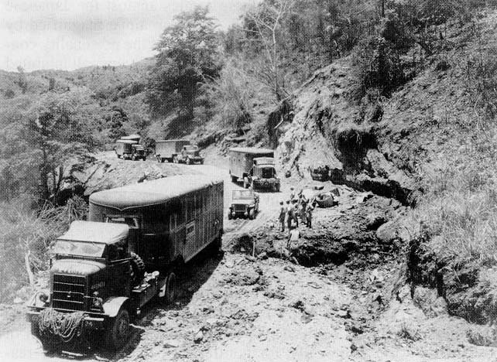
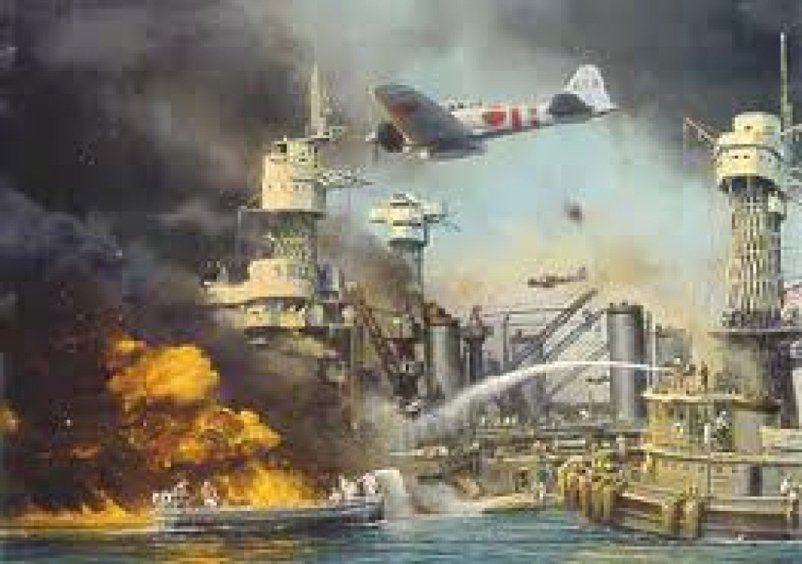
WW2 in China 1939-1945
For the next 5 years, Japan lacked the resources and manpower to make further inroads into China.
Britain and the USA began to send millions of tons of supplies to Chiang from Burma. He withheld these from the Communists.
From 1941 Japan was preoccupied with the Pacific War with the USA.

Slide 12
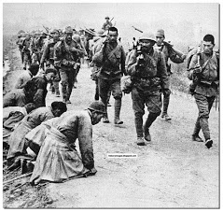
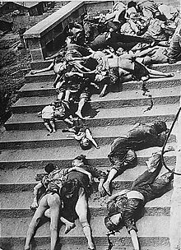
The Limits of Empire
Even in the areas they occupied, the Japanese did not have total control.
This allowed the Chinese to move back into some areas and take control of the countryside.
The Japanese controlled the large cities, ports & airfields whilst the KMT & CCP controlled most of the countryside.

Slide 13
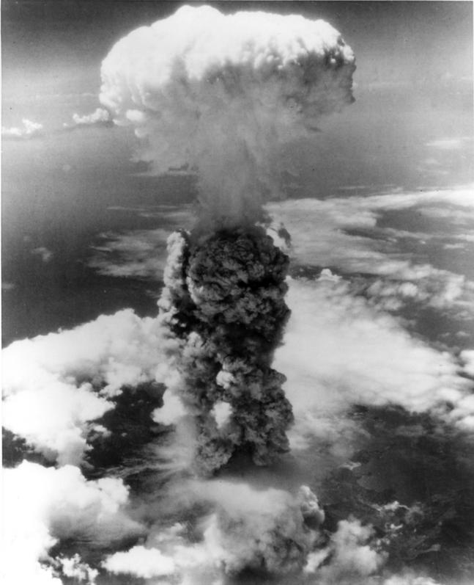
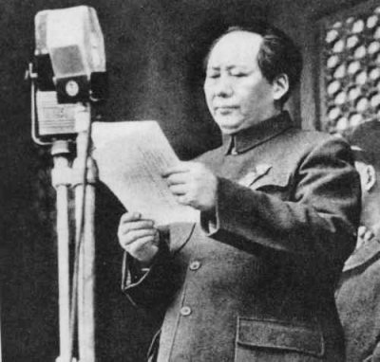
The Outcome of the War
Before the Invasion in 1937, the CCP controlled only 30,000 sq. miles with 2 million people.
By 1945, the CCP controlled 300,000 sq. miles with 95 million people.
Read the worksheets to find out how the CCP managed to gain so much support during the war.

