Slide 1
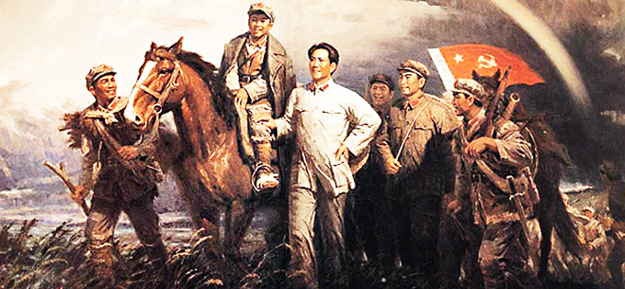
How important was the ‘Long March’ to Mao’s eventual success?
L/O – To identify and evaluate the key features and significance of the Long March

Slide 2
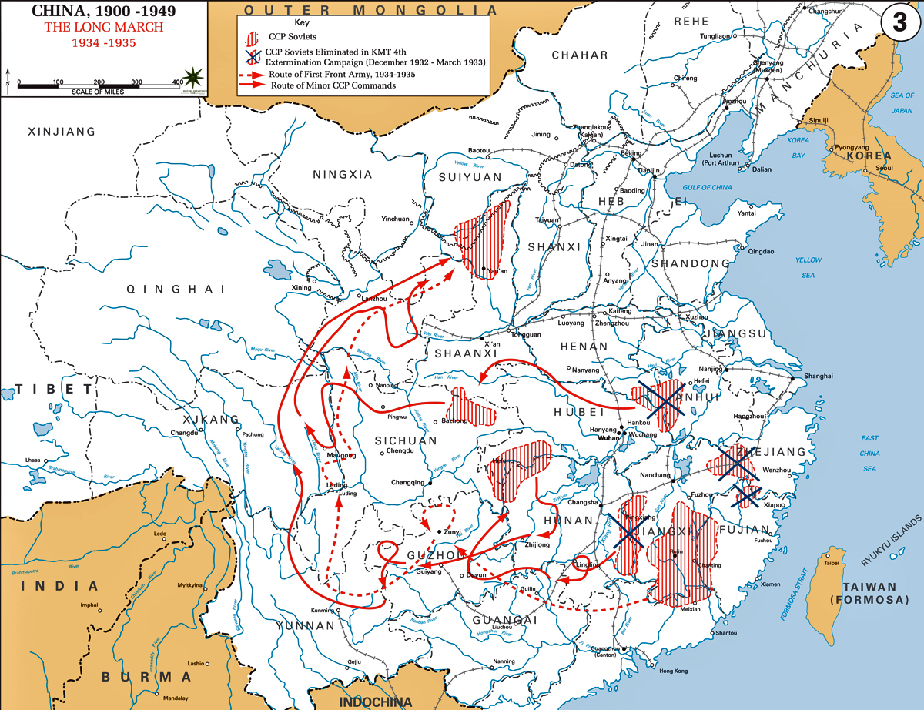

Slide 3
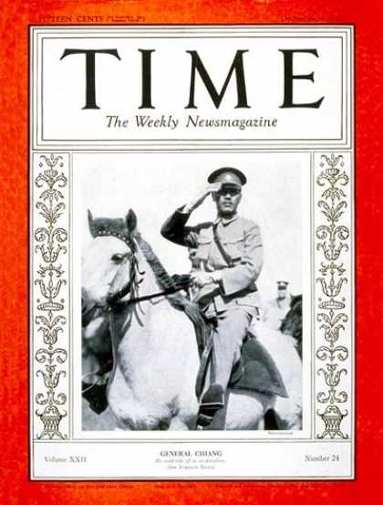
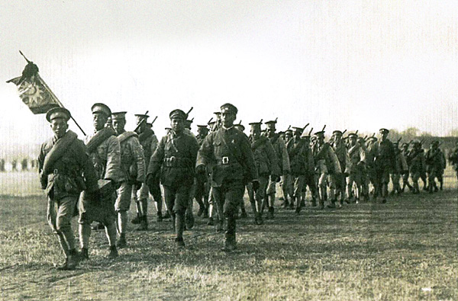
The Northern Expedition 1926-1928
Chiang finally removed the warlords with the help of the CCP in 1928.
Peasants & workers welcomed Chiang’s armies & there was little resistance from the warlords.
China was now reunified and Chiang’s government was recognised by foreign powers.

Slide 4
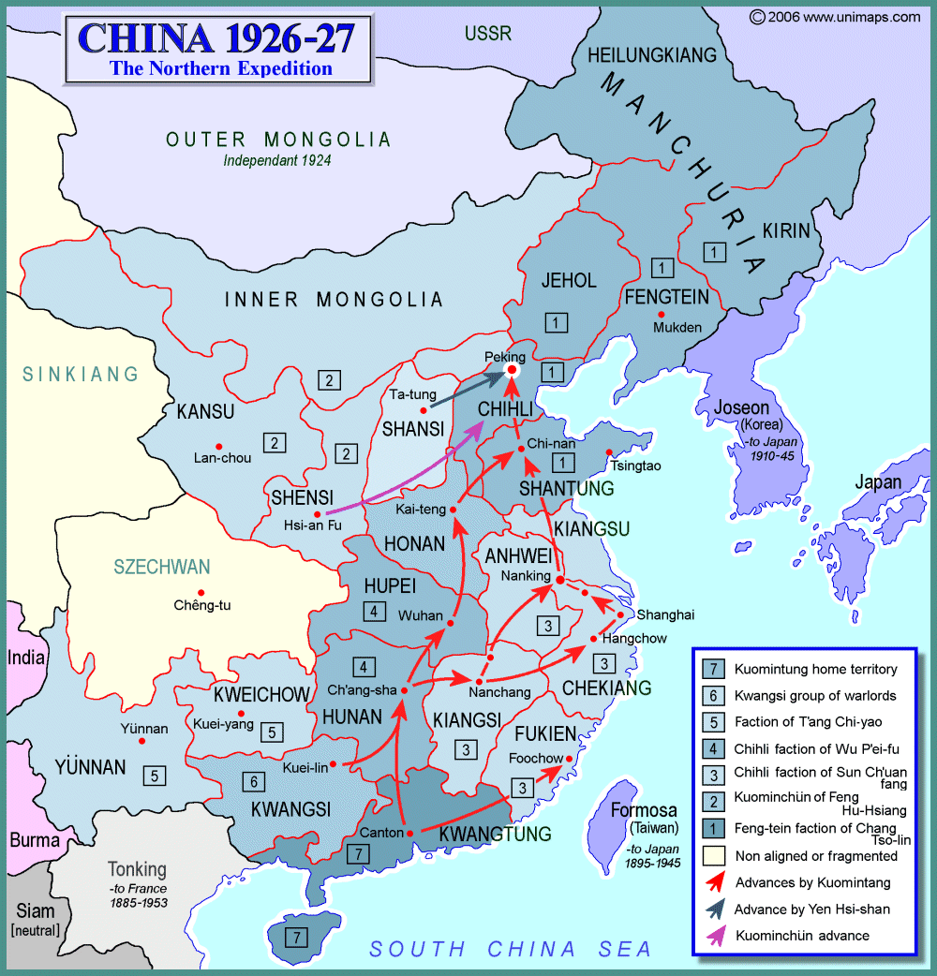

Slide 5
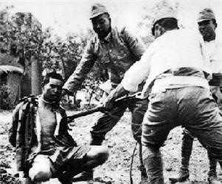
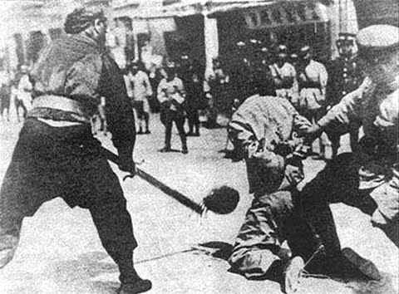
The Shanghai Massacres - 1927
Chiang feared the growing influence of the CCP, especially in Shanghai.
In 1927 he turned on them & the KMT sent an army to Shanghai. The workers of Shanghai rebelled against the warlord in the area.
When Chiang’s army arrived, it executed all the Communists it could find.

Slide 6
Reorganising the CCP – 1927-1934
Many Communist like Mao escaped to the province of Kiangsi where Mao setup the Kiangsi Soviet and Red Army which had 11,000 members by 1930.
Support grew for the CCP as land was redistributed to peasants.
The Red Army trained in Guerrilla Warfare and was told to respect peasants.
The Eight Rules of the Red Army
Speak politely
Pay fairly for what you buy
Return anything you borrow
Pay for everything you damage
Don’t hit or swear at people
Don’t damage crops
Don’t take liberties with women
Don’t ill-treat prisoners

Slide 7
The Extermination Campaigns
Chiang was determined to crush the Kiangsi Soviet. Between 1930-1934 he launched 5 massive extermination campaigns.
The first 4 were failures due to the guerrilla tactics used by Mao’s forces. However over a million civilians were killed. Mao was criticised.
Mao on the tactics of the Red Army, 1930
When the enemy advances, we retreat.
When the enemy halts, we harass.
When the army retires, we attack.
When the enemy retreats, we pursue.

Slide 8
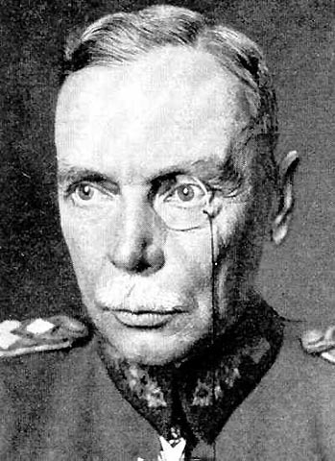
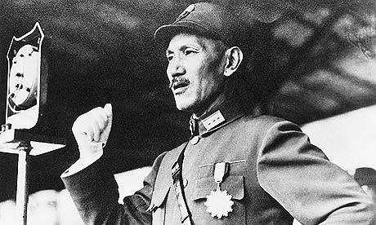
The Fifth Extermination Campaign
In Summer 1933, Chiang used new tactics suggested by General Hans von Seeckt, a German military advisor.
Seeckt used ‘blockhouse’ tactics. The KMT surrounded the Kiangsi Soviet with ½ m troops and advanced slowly building blockhouses, digging trenches & putting up barbed wire fences.
This prevented food getting in or out.

Slide 9
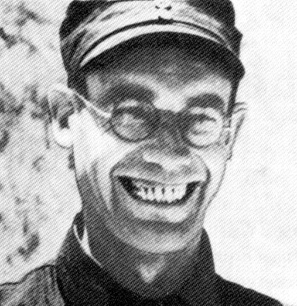
The Fifth Extermination Campaign
The Communists abandoned Guerrilla Warfare and under the influence of Otto Braun, launched a series of disastrous pitched battles.
By summer the communists were surrounded by four lines of blockhouses & close to starvation.
By Oct 1934, they had lost ½ of their territory as well as 60,000 troops.
Otto Braun – German Communist and Comintern agent who was sent to China by Soviet Russia to give military advice to the CCP

Slide 10
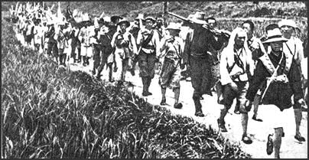
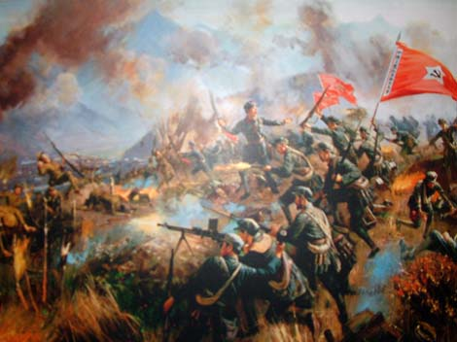
The Break Out – October 1934
On the suggestion of Otto Braun, on 16th Oct 1934, 87,000 soldiers began a retreat.
They took as much equipment & guns as they could carry and took them 6 weeks to break out of the ring of blockhouses.
At the end of Nov 1934, the Red Army reached the Xiang River and lost over half their number fighting the KMT.

Slide 11
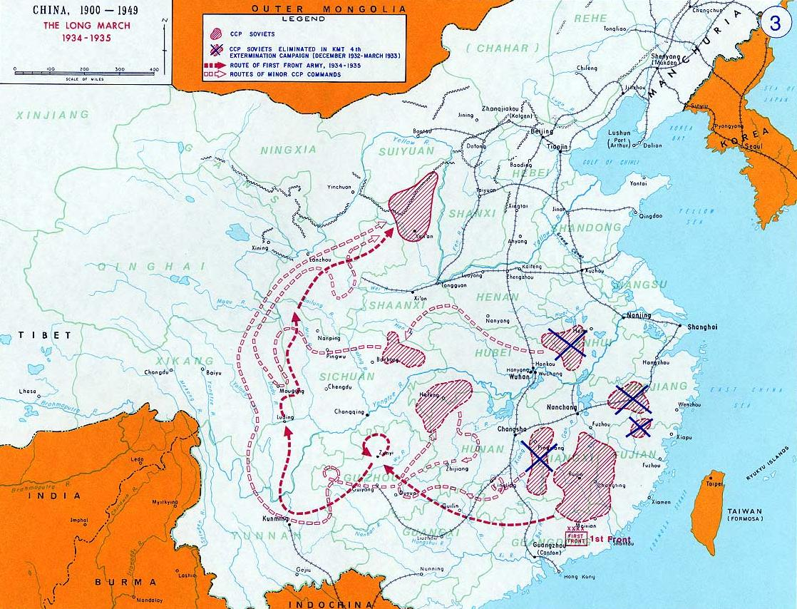

Slide 12
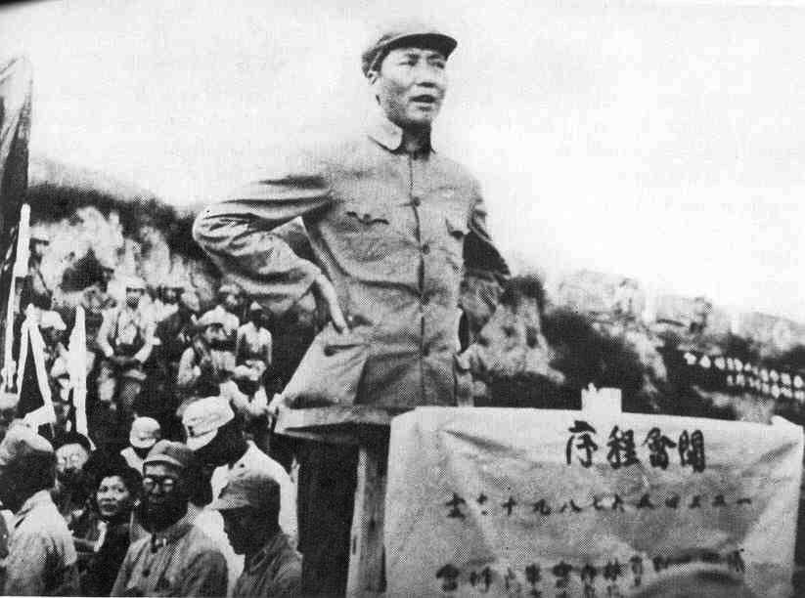
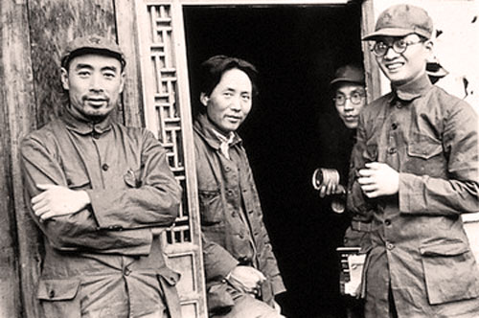
Mao Takes Over – January 1935
In Jan 1935 they reached Zunyi, where a meeting was held. Braun was blamed for the defeat at the Xiang River:
  He had allowed them to carry to much equipment which slowed them down.
  The retreat was in a straight line which helped the KMT predict where they were headed.
Leadership of the march was handed to Mao and Zhu De.

Slide 13
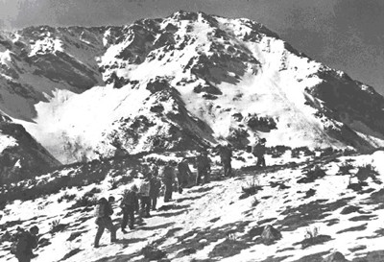
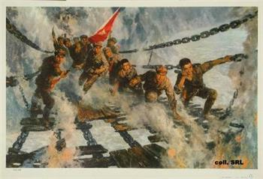
Progress in 1935 – January-October
Under their new leadership, the march took off in a new direction, often changing routes & splitting forces.
One of the most famous events was the crossing of the Dadu River. 22 soldiers swung across the river gorge on chains whilst under fire.

Slide 14
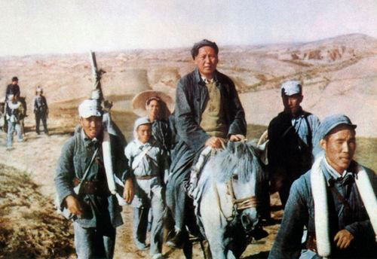
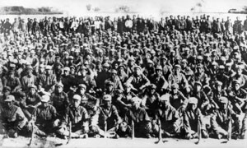
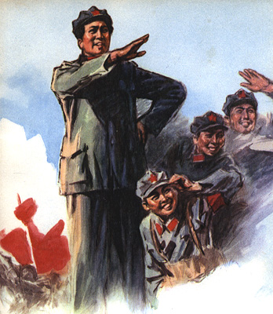
Arrival – October 1935
In October 1935 they had reached their destination of the poor communist base at Yanan in Shaanxi province. They had:
  Fought dozens of battles
  Crossed 24 rivers
  Crossed 18 mountain ranges
  Covered 24 miles a day
  9000 kilometres in total
  10,000 reached destination out of 100,000

Slide 15
Importance of the March
The CCP had survived and found a new base which was remote and safe from attack from the KMT & Japanese
Mao was hailed as a great hero and was re-established as the unchallenged leader of the CCP
Many Chinese saw the CCP as heroes & Long March became part of CCP mythology
The good behaviour of the Red Army impressed peasants
1.) Which is the most important consequence of the march? Why?
2.) How did the success of the march help boost CCP support across China?

Slide 16
Section C - Exam Question
(a) ‘What does this Source tell us about the events of the Long March?’ (3)
(b) ‘Describe the key features of EITHER the Long March OR the Great Leap Forward’ (7)
“For twelve months we were under daily reconnaissance and bombing from the air. We were encircled, pursued, obstructed and intercepted on the ground by a force of several hundred thousand men. We encountered untold difficulties and obstacles on the way, but by keeping our two feed going we swept across a distance of more than 10,000 km…Has there ever been a long march like ours?”
The Communist Leader Mao Zedong - 1949

Slide 17
Mark Scheme
Question A | Mark
One factor | 1 mark
Two factors | 2 marks
Three factors | 3 marks
Question b | Mark
Simple or generalised statements of key features | 1-2
Developed Statements of key features | 3-5
Developed explanation of key features | 6-7

