Slide 1
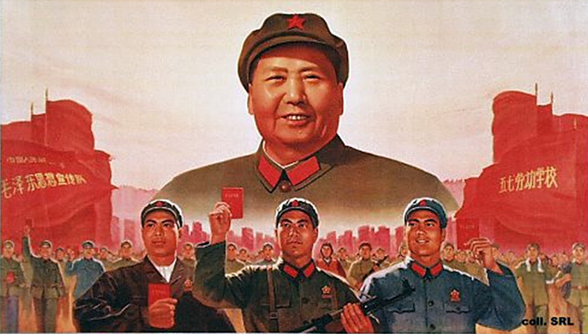
The Cultural Revolution
L/O – To identify and explain the key features of the Cultural Revolution (reasons, features, effects)

Slide 2
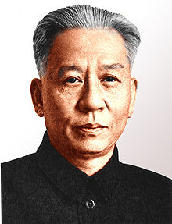
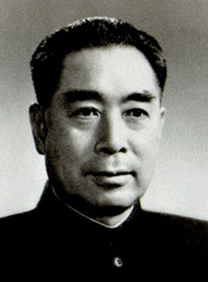
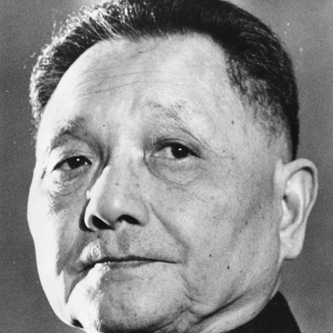
Mao Resigns
Mao resigned as President of China in 1959. He remained as Chairman of the CCP. China was now controlled by three leading Communists:
President, Liu Shaoqi
Prime Minister, Chou En-lai
The CCP General Secretary, Deng Xiaoping
All three solved the problems created by the Great Leap Forward by re-introducing some central control of the economy and planning by ‘bureaucrats’.
Why would these changes to the economy worry Mao?

Slide 3
Revolution Declared
“It doesn’t matter if the cat is black or white; so long as it catches the mouse, it is a good cat”
Deng Xiaoping, June 1962
By mid 1960s Mao was becoming concerned about the direction of China under Liu Shaoqi & Deng Xiaoping.
Middle-class experts and townspeople again seemed to be getting wealthy at the expense of the peasants.
In 1966 he summoned the young people of China to Tiananmen Square and told them that the revolution was in danger from leaders of the CCP.
Considering how committed Mao was to Communist ideology, do you think he would agree with Deng’s statement?

Slide 4
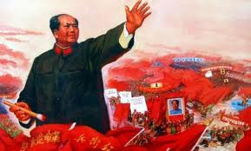
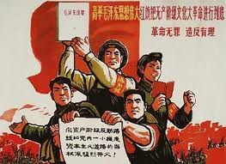
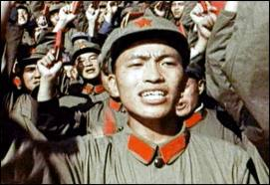
Revolution Declared
These ‘Red Guards’ were told that they had the task of saving the revolution.
Mao called for young people to rise up and rid China of the anti-Communist elements within the Party, schools, universities and society.
The events which followed became known as the ‘Cultural Revolution’.

Slide 5
Motives for the Cultural Revolution
Mao had several motives for carrying out the Cultural Revolution:
1.) Power Struggle – After the GLF, Mao’s own political position was weakened and his economic policies rejected. He wanted to defeat his opponents and regain political supremacy.
2.) Purify Communism – Mao hated the development of a new CCP middle class which he saw as corrupt. He also labelled the economic reforms of moderates as ‘capitalist’ or ‘Revisionist’. Chinese culture also had to change.
3.) Education & Culture – Education was attacked as it produced this ‘bureaucratic class’. It needed to be more revolutionary, less academic. Traditional Chinese culture was seen as ‘Bourgeois’.
4.) Mao’s Comeback – Mao was confident enough to launch the Cultural Revolution as from 1965 he gained the support of Lin Biao and the PLA. He created the ‘Red Guards’ and used propaganda to ensure support.

Slide 6
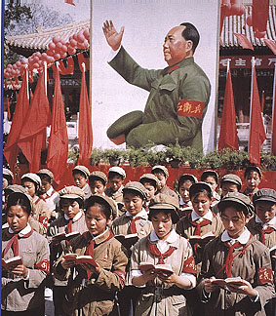
Who were the ‘Red Guards’?
Mao told the young students of China to form themselves into Red Guards.
They were loose grouping of college and secondary school students who embraced the cult of Mao and the aims of the Cultural Revolution.
They were formed to struggle against teachers but quickly took on a larger role.
Why did Mao decide to mobilise young people to promote the Cultural Revolution?

Slide 7
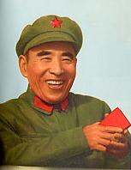
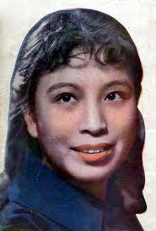
What did they target?
“If the proletariat does not occupy the positions in literature and art, the bourgeoisie certainly will.”
Lin Biao, Head of the PLA
The Red Guards were supported by the PLA under Lin Biao and Mao’s wife Jiang Qing.
Mao denounced the ‘Four Olds’: Old Culture, ideas, customs and habits. Jiang Qing turned Mao’s slogan into a programme for the eradication of traditional Chinese culture.
A ‘Proletarian Culture’ was to be created and Lin Biao ordered the PLA not to oppose the Red Guards who attacked anything seen as ‘capitalist’ or ‘bourgeois’.

Slide 8
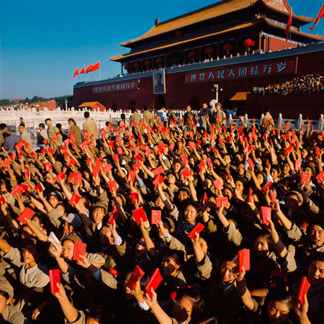
What did they target?
Aug 1966 - Mao ordered them to ‘bombard the headquarters’ and attack the CCP from the top down. They soon went on the rampage.
Children denounced their own parents as anti-Communist. Schools closed and many teachers were beaten and abused.
By 1967 law & order had broken down as Red Guards fought ‘reactionaries’ with the death of over 400,000 across China.
“We are the critics of the old world; we are the builders of the new.”
Red Guard Slogan

Slide 9
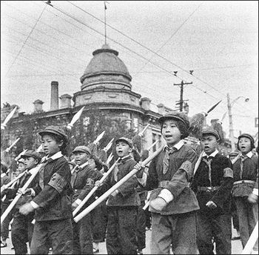
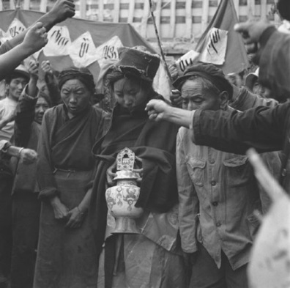
What did they target?
They shaved off the hair of girls with Western haircuts and ripped off Western-style clothes.
Smashed windows of shops selling Western merchandise.
Burnt bookstores, libraries and closed museums, art galleries, churches, temples and theatres.
Stopped couples from holding hands.
In August 1967 the British Embassy in Beijing was stormed.

Slide 10
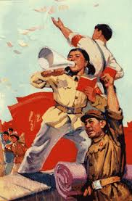
Attacks on the Party
After attacking the Four Old’s, Jiang Qing urged the Red Guards to attack what she called ‘black dogs, slippery backsliders and rotten eggs’ within the CCP.
Lin Shao-chi was the main target. He was accused of being ‘No. 1 enemy of Communism’.
He was physically attacked and forced to write his own confession. He died in 1969 after being refused medical treatment for diabetes.

Slide 11
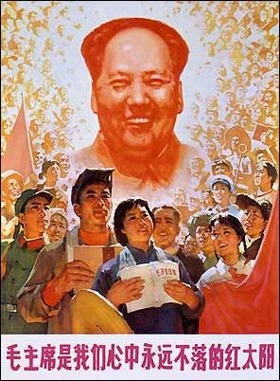
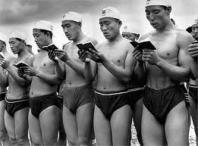
The Cult of Mao
During the Cultural Revolution, the ‘Cult of Mao’ developed. Mao was worshipped as the new emperor.
Every day workers would gather before his portrait and read from his ‘little red book’.
740 million copies were printed between 1966-1969.
Statues and portraits of Mao were put up everywhere.

Slide 12
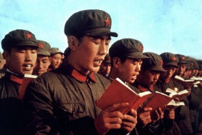
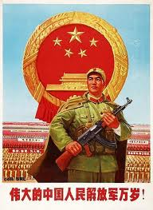
End of the Revolution
By 1967, the Cultural Revolution was spinning out of control. The Red Guards began to divide into rival factions. Mao attempted to restore order.
The PLA was used to restore order. Mao then sent the Red Guards to the countryside to ‘re-educate’ themselves by learning from the peasants.
By 1969 law and order had been restored in most areas. Mao once again had supreme control over China but over 1 million people had been killed.

Slide 13
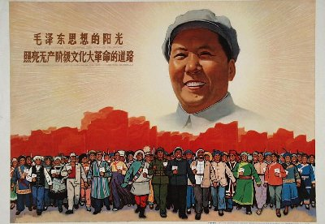
Effects of the Cultural Revolution
1. Industry
Factories were reorganised to give power to the workers. Prizes and bonuses for workers were abolished. All workers given equal wages. Technicians were dismissed and production fell. Transport ground to a halt.
2. Education
Seriously disrupted. Students refused to sit exams as they showed up inequalities. All students were now made to learn from peasants and factory workers on work experience. Some schools were closed for over two years.
3. Countryside
Students and graduates sent to work alongside peasants. Private land taken away from the peasants again! Markets and restaurants closed in villages.
4. Government
Opponents were killed or sent into exile. Deng Xiaoping was removed. Revolutionary committees were set up by the PLA to run the country instead of government. CCP members sent to countryside for ‘re-education’.

Slide 14
Why do you think Mao launched the Cultural Revolution?
Genuinely concerned that China was becoming too conservative?
Wanted to regain power after the failure of GLF?
Wanted a committed army to fight the USA in Vietnam?
He disliked other Communist leaders?
He was out of touch. Was acting like an ageing emperor and was only interested in controlling people?

Slide 15
Explain how the Cultural Revolution affected…
Mao’s position in China
Industry in China
Education in China
Attitudes to Communism

Slide 16
In what ways did the policies of Mao bring change to China in the years 1952-1969? (15 marks)
You may use the following information to help you with your answer:
Because…
The first Five Year Plan
The Hundred Flowers Campaign
The Great Leap Forward
The Cultural Revolution
This led to…
As a consequence…
As a result…
Moreover…
In addition…
Furthermore…
Focus on writing about changes. Do not just tell the story.
Use at least 3 of the scaffolding points. You can use your own.
Write a paragraph on each. Give the change then explain it.
Make links! Explain how one change led to the next.
Write a conclusion showing how the factors acted together to bring about change.

Slide 17
In what ways did the policies of Mao bring change to China in the years 1952-1969? (15 marks)
Brief Introduction – i.e. ‘Mao’s policies did improve China at first but actually ended up causing lasting damage by 1969.’
The first Five Year Plan – Give the change and then explain it. Make a link to the next change.
The Hundred Flowers Campaign – Give the change and then explain it. Make a link to the next change.
The Great Leap Forward – Give the change and then explain it. Make a link to the next change.
The Cultural Revolution – Give the change and then explain it. Make a link to the next change.
Conclusion – Explain how the factors you have written about acted together to bring about change. i.e. Overall, all four policies brought major changes to China but not all were positive. Whilst the first Five Year Plan did boost industrial & agricultural production, the growth in a bureaucratic class angered Mao into reversing the positive changes that had been made. The Hundred Flowers Campaign marked an end to this progress because…

Slide 18
In what ways did the policies of Mao bring change to China in the years 1952-1969? (15 marks)
The first Five-Year Plan brought important changes to China in industry and agriculture. In agriculture, once again there was a change in organisation and ownership. The Plan set up lower-stage co-operatives consisting of thirty or forty families. Members of the co-operative pooled their land and labour to make bigger and, hopefully, more efficient farms. In industry, the Plan gave priority to the expansion of heavy industry, more especially steel, coal and machinery, and led to the setting up of many production plants, especially in the centre of China. This resulted in great expansion in heavy industry but led to the neglect of lighter, consumer industries such as cotton-making and food processing.

Slide 19
Question C – Mark Scheme – 15 marks
Level | Descriptor | Mark
Level 1 | Simple or generalised statements of change Statements lack any supporting contextual knowledge or makes generalisations. | 1-4 1-2 for repetition of the provided events with no development. 3-4 for unfocused description.
Level 2 | Developed Statements of change Developed statements using the stimulus and/or additional material. Mostly relevant and accurate but with an implicit focus on the question. | 5-8 5-6 for mainly narrative or one event only. 7-8 Develops two or more events or other relevant information.
Level 3 | Developed Explanation of change Developed explanation of more than one factor from events and/or additional material and is able to make links between some factors. The answer mainly focuses on the question. | 9-12 9-10 – considers a variety of factors but links implicitly. 11-12 – considers a variety of factors and links explicitly.
Level 4 | A Sustained Argument This considers the inter-relationship between a range of factors from the events and/or additional material and makes judgements on the extent of change and/or continuity. | 13-15 13-14 – Addresses inter-relationship between various factors. 15 – Addresses the extent of change and/or continuity.

