Slide 1
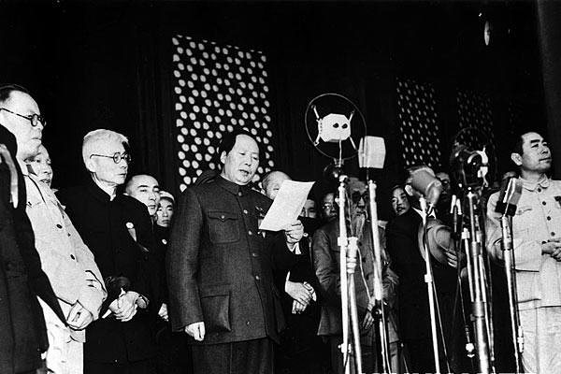
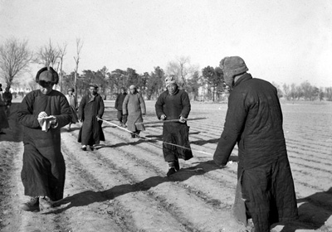
How did Mao change China 1949-1957?
L/O – To examine the agricultural, industrial and social reforms of the Communists between 1949-1957
Notes:
Video = 1.30.18 – 1.53.32

Slide 2
What problems did Mao have in 1949?
Try to think about the legacy of the Second World War and Civil War on China
Mao’s Problems in 1949
Economic?
Political?
Foreign?
Social?
Industrial?
Agricultural?

Slide 3
China’s Problems in 1949
Political | Economic | Social | Foreign
The CCP had to prove that they were capable of providing a strong and effective government. Opposition to the government had to be removed or brought under control. | It was very poor. Industrial production was 50% down on the best pre-war figure and food production was down by 25%. Manchuria, China’s most industrialised region, had been occupied by the Japanese. There was rapid inflation. | Most of the people were peasants who could not read or write. The Chinese people did not want change. They mistrusted all modern ideas in farming, industry, education, medicine and women’s rights. | Most of the world refused to recognise the CCP. The USA continued to recognise the Kuomintang in Taiwan. Only the Soviet Union would help the new China.

Slide 4
Mao´s aims
Communist system: rule, economy, daily life
Modernisation of Chinese economy

Slide 5
Agricultural reform
Draw a flow chart to explain why agriculture reform leads to modernisation.
Write a paragraph explaining why Mao wanted to increase the production of food.

Slide 6
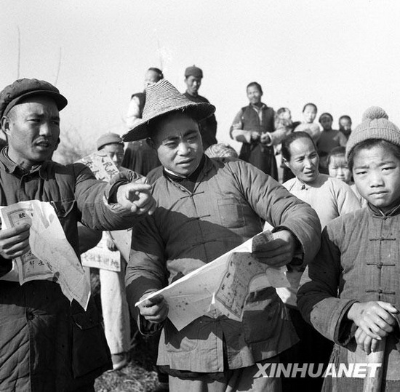
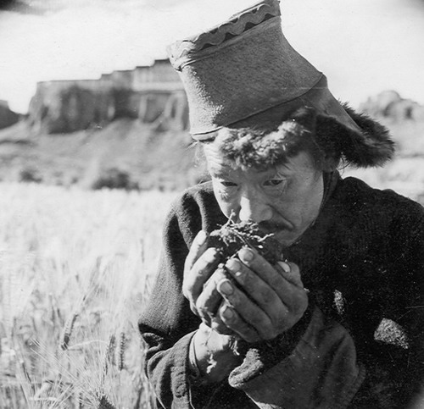
How did Agriculture change?
In 1950 Mao introduced an Agrarian Reform Law. He sent CCP workers into each village to enforce it.
They took the land from landlords and shared it out amongst village peasants.
They also got peasants to put landlords on trial in so-called ‘People’s Courts’.

Slide 7
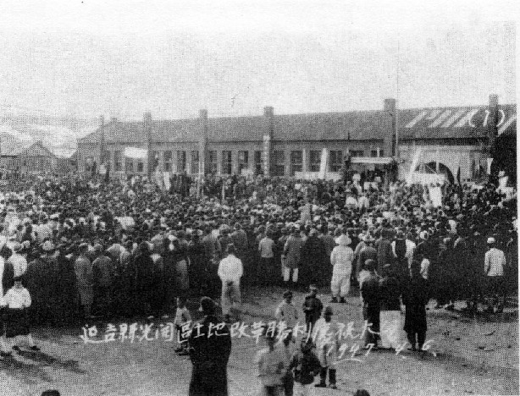

Slide 8
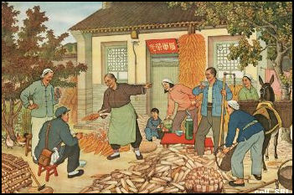

Slide 9
People’s Courts
Mao wanted the executions to have maximum impact by involving peasants in the killing and having executions in public:
“Peasants who killed with their bare hands the landlords who oppressed them were wedded to the new revolutionary order in a way that passive spectators could never be.”
From P. Short, Mao: A Life, 1999
At these trials the landlords were accused of charging high rents or mistreating their tenants.
Some were let off, but many landlords were imprisoned or executed. Party workers set up the courts but peasants ran them. Why?
Between 700,000 – 3 million landlords were executed. This further increased support and faith in Mao. Why?

Slide 10
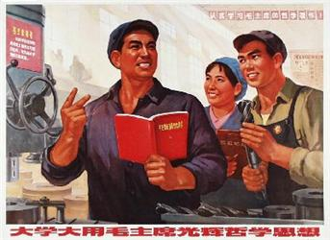
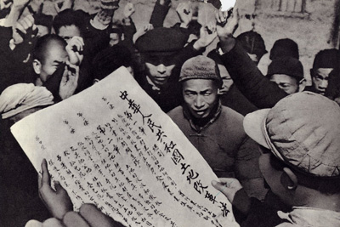
Population ↑, Food Production ↓ = ?
Land reform made Mao popular but in the short-term it only decreased productivity.
Mao eventually planned to ‘collectivise’ farming to raise productivity, but this would only anger peasants who has just won their own land.
The population was growing and to avoid famine, Mao slowly tried to persuade peasants to work together to raise food production.

Slide 11
Mutual Aid Teams
“In 1951 we set up a Mutual Aid Team. The work went well, but there were lots of quarrels about whose land should be worked on first. It was difficult to solve all these problems. Some said ‘Why should his field be taken first? I’ve got a bigger crop.’ Whatever we did this went on. So we then began to talk about forming a peasant’s co-operative.”
His first step was to introduce Mutual Aid Teams.
Peasants worked on each other’s land, fertilising, killing pests or harvesting so that each family’s plot would become more productive.
Government supplied extra fertiliser & tools to reward hardworking families but it did not raise productivity enough.

Slide 12
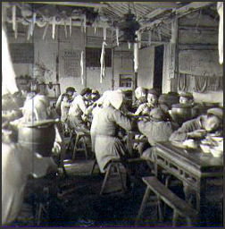
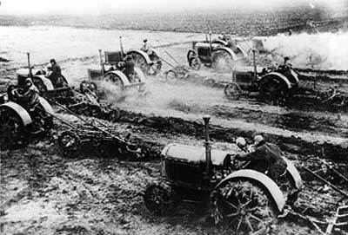
The Co-operatives
From 1953, Mao encouraged peasants to form co-operatives.
This meant land was jointly owned so one large crop could be grown efficiently. Resources could be pooled to buy equipment, fertilisers & seeds.
Some peasants opposed this (Why?) but by 1957, over 90% of China’s peasants belonged to co-operatives.

Slide 13
f
1953 – All peasants encourage to join co-operatives
1957 – Over 90% of peasants now in co-operatives
1951 – Mutual Aid Teams set up

Slide 14
How did Agriculture Change?
What was Chinese farming like before 1949?
How did peasants deal with the landlords?
How did farming methods change?
Did peasants attitudes to reforms change over time?
Were the changes in farming successful?

Slide 15
The Great Famine 1958 - 1962
Causes:
Forced collectivisation
Mao changed farming methods
No incentives (no profit) – couldn´t sell extra
4 Noes campaign (no birds = more insects = crops and grain eaten = low productivity)
Political pressures (peasants punished for using tradition farming methods – enemies of the state. AND believed incorrect scientific methods from USSR.
Fear
Natural causes

Slide 16
Results of Great Famine
50 million deaths
Sold children and wives to buy food
Cannabilism: sold human flesh on the market, swapped children so wouldn´t have to eat their own
“Shallow burials are prohibited.
All corpses must be buried at least three feet deep and crops must be grown on top. No burials are allowed near roads. All crying and wailing is forbidden. The wearing of mourning clothes if [sic] forbidden.”

Slide 17
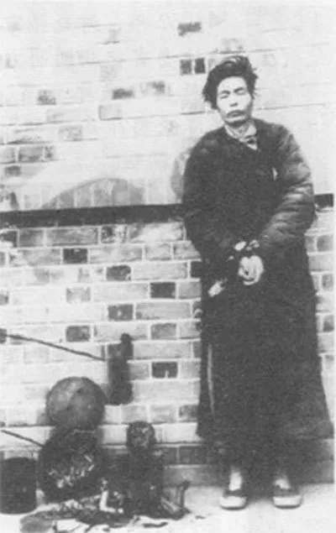

Slide 18
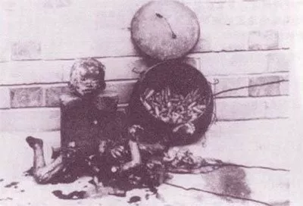

Slide 19
A disturbing account from a witness was recounted by Yang Jisheng, who authored “Tombstone,” a comprehensive account of the Great Chinese Famine.
“I went to one village and saw 100 corpses, then another village and another 100 corpses. No one paid attention to them. People said that dogs were eating the bodies. Not true, I said. The dogs had long ago been eaten by the people,” the person said.

Slide 20
How did Industry change?
When the CCP took over the economy was in ruins. Industry had been destroyed and inflation was over 1000%.
Mao introduced a series of measures to deal with this chaos:
1. Mao ordered prices and wages to be fixed at a low rate. He punished black marketeers severely. Inflation was down to 15% within a year.
2. He increased the taxes paid by business and in 1953 took over all businesses. Government planned and organised what should be produced.
3. He took over private banks and introduced the ‘People’s Bank’ in 1951. This helped to stabilise the currency.
4. Railway links were repaired and taken over by government so that industries could be supplied with coal.

Slide 21
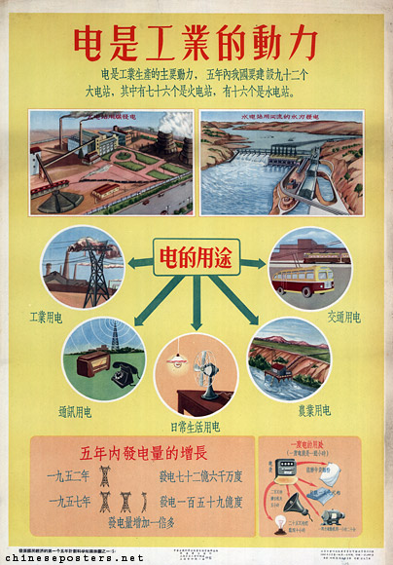
The Five Year Plan 1953-1957
By 1953 the economy had stabilised and Mao began the first 5 Year Plan.
With the help of the USSR he began an ambitious programme to build new industries.
Thousands of Russian scientists and engineers supervised millions of Chinese on over 700 major projects.
Why do you think Mao used help from the USSR?

Slide 22
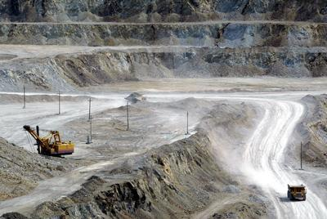
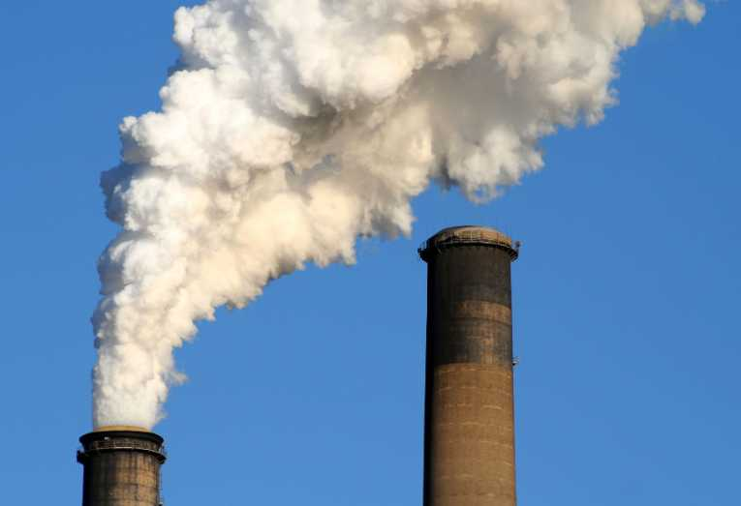
The Five Year Plan 1953-1957
The focus was on heavy industries – steel, coal, chemicals. These would provide the raw materials to build planes, trains and engines which would improve transport.
Why was the emphasis of the Five-Year Plan on heavy industry?

Slide 23
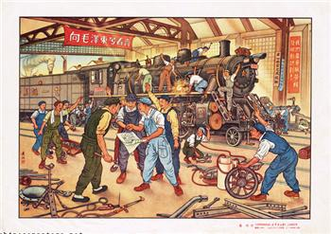
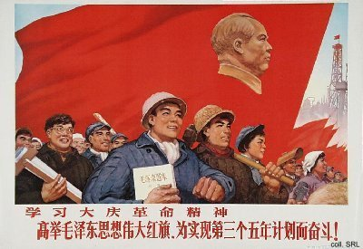
The Five Year Plan 1953-1957
The plan achieved astounding results. Motivated Chinese workers surpassed all the targets.
In five years, China was criss-crossed with railways which moved vital goods over vast distances.
The population of cities soared as peasants moved to the jobs created in the new industries.

Slide 24
Social Reforms
Look at page 271. Make a spider diagram of the major social changes.
During the 1950s Mao attempted to modernise and reform many other aspects of life in China such as:
Education
What do you think was the purpose of these reforms?
Women’s Rights
Healthcare
Sanitation

