Slide 1
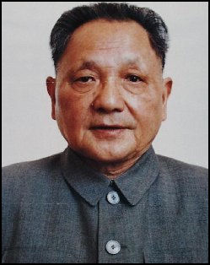
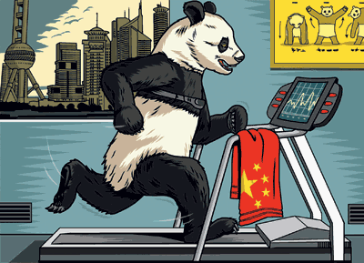
How did Deng Modernise China?
L/O – To explain the significance of the changes introduced by Deng Xiaoping in the 1970s and 1980s
Deng Xiaoping

Slide 2
The Emergence of Deng
The Four Modernisations = the development of agriculture, industry, national defence and science.
Between 1976 and 1980 the moderates slowly gained control of China. Deng Xiaoping returned to power in 1977 as Deputy Chairman of the Party as well as Deputy Prime Minister.
Under Deng, China began a period of moderate policies following all the upheavals of Mao. Deng was determined to carry out the Four Modernisations of Zhou.
These reforms were launched at the 3rd Plenum of the Communist Party in December 1978.
“The reforms introduced by Deng in 1978 marked the beginning of a new era in Chinese history.”
Do you agree? Explain your answer.

Slide 3
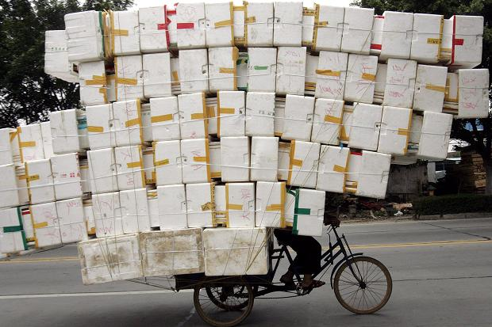
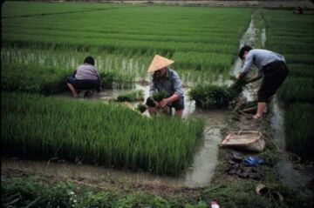
Reasons for Deng’s Reforms
Deng’s main concern was to improve and modernise the Chinese economy.
Many machines were old-fashioned and factories were inefficient, running at a loss.
Co-operative farms were failing to produce enough food. In 1982 China had to import 13.7 million tons of grain.
Grinding poverty was made worse by serious droughts and floods in 1980-1981.
The way to solve these problems was to therefore increase output in industry and agriculture.

Slide 4
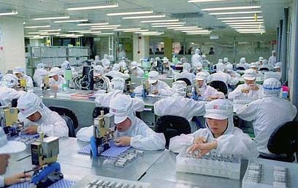
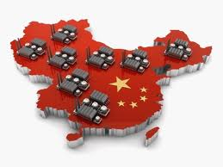
1. Industry
In 1979, a new 10-Year Plan was introduced. New factories were built and workers were paid bonuses for extra output. People were even free to own businesses!
Record number of consumer goods were produced such as bicycles, watches and sewing machines.
Foreigners were encouraged to visit China and invest money in industry, even from the USA.

Slide 5
1. Industry
“It was discovered that in one area there were two million pairs of shoes piled up in warehouses. Nobody was buying them because the style was old-fashioned, yet the factories were still producing them because the managers were under order to do so.”
Less control from the centre – Deng told managers to run factories profitably and to produce what people wanted to buy.
Factories therefore started to produce based on supply and demand (capitalism) NOT due to state planning (communism).
Deng also created ‘Special Economic Zones’ (SEZ) and ‘open’ coastal sites. These areas provided cheap land and local labour to Western firms. Western firms were then encouraged to hire Chinese workers and use Chinese raw materials.

Slide 6
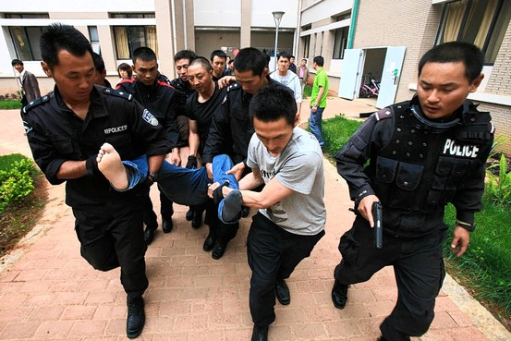
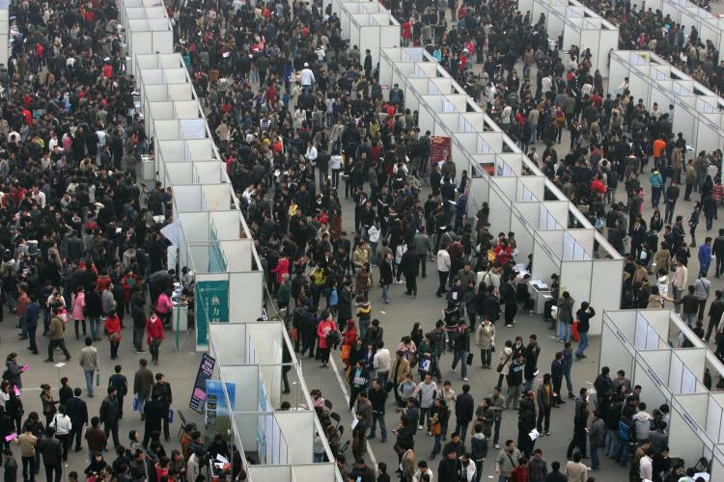
Problems of Industrial Development
A TV cost two years’ wages and a bicycle a month’s pay in the mid 1980s.
Unemployment still stood at 12% in 1983.
Modernisation brought Western-style problems such as rising crime and even football hooliganism.
Inequalities in wealth and wages increased the potential for social conflict. In 1985, Beijing Bus Drivers went on strike after finding out they earned only half the wages of taxi drivers!

Slide 7
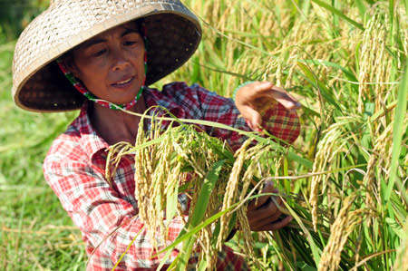
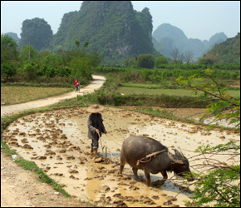
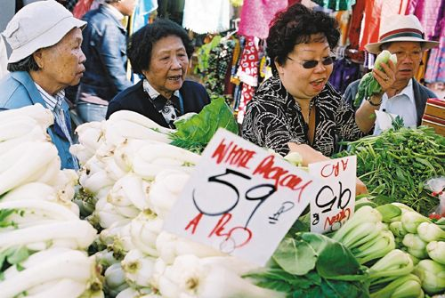
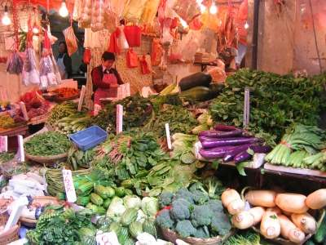
2. Agriculture
The size of peasant plots were increased. A ‘Responsibility System’ for commune land was started in 1978, by which families were given responsibility for cultivating areas of land.
They signed contracts promising to produce fixed amounts of food for sale to the state, and were allowed to sell any surplus at markets for profit.
By 1983, China had 44,000 markets as farmers could sell their produce privately. The income of agricultural workers tripled between 1977 and 1983.

Slide 8
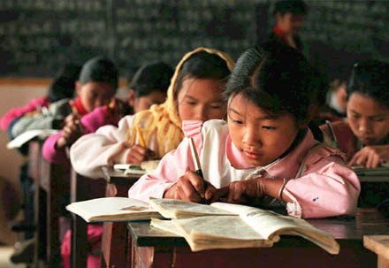
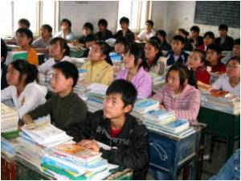
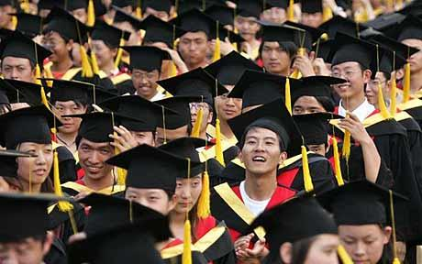
3. Education
The reforms of the Cultural Revolution were reversed. Examinations for University entry were restored. Success in academic subjects once again became essential.
Special schools for the best students were set up to provide China with the skills needed to prosper.
Time spent on political education and manual labour was reduced.

Slide 9
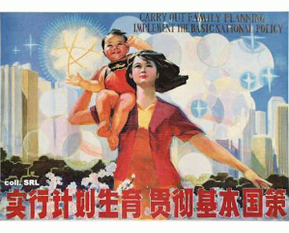
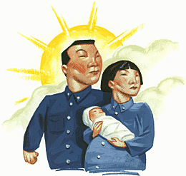
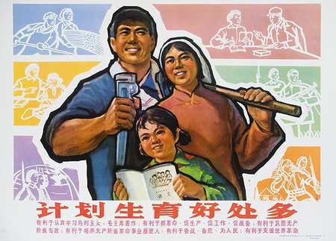
4. Birth Control
In 1979, Deng introduced the ‘one-child’ family policy. It was estimated that by 2000, China’s population would be 1.282 billion.
The one-child policy introduced a series of measures to discourage couples having more than one child:
Minimum age for marriage – 20 for women, 22 for men
Couples wanting to marry had to get consent of commune and take a written test in family planning.
Better allowances were given to one-child families and people who were sterilised got cash and holidays!

Slide 10
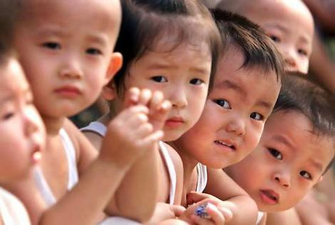
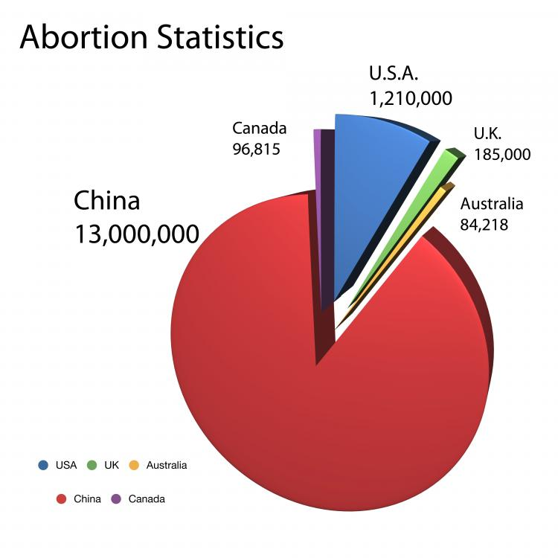
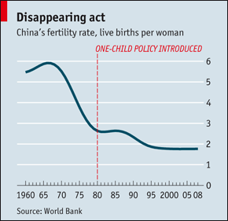
4. Birth Control
The one-child policy was effective in towns where it was easier to police but was difficult to enforce in the countryside.
The birth rate did slow down but it produced problems such as:
It encouraged late and compulsory abortion.
In China only sons are supposed to continue the family line. The birth of a daughter was thus greeted with disappointment. Discrimination against girls and even infanticide.

Slide 11
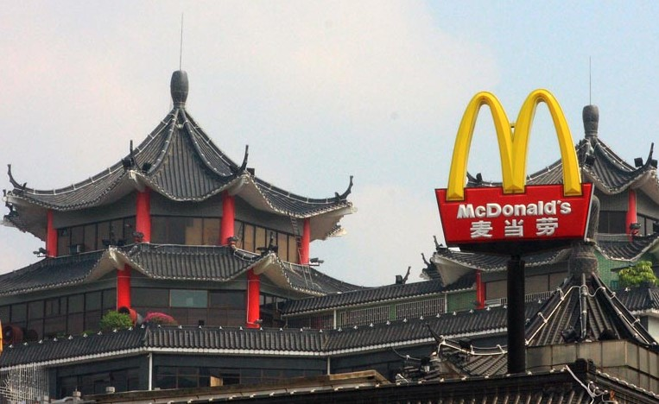
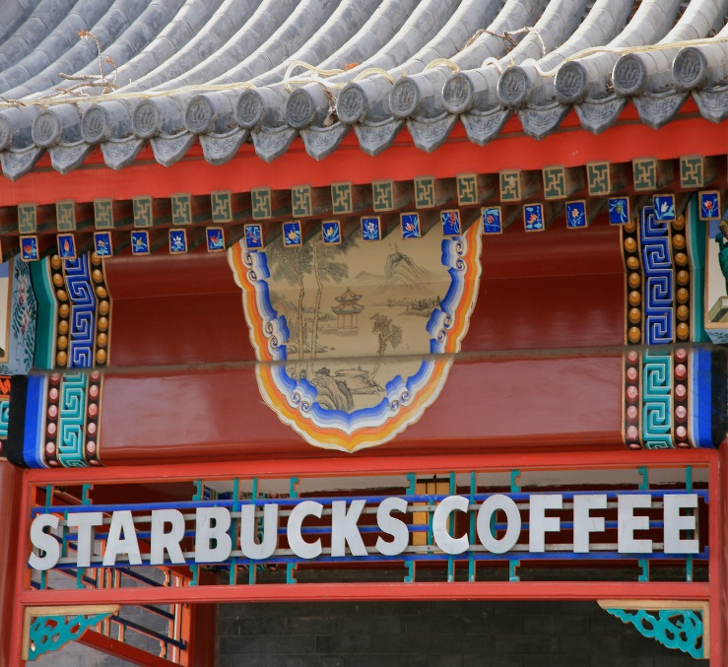
5. Westernisation
China became a more open society after Deng’s return. On TV, people could watch news about the USA or the Pope.
Foreign books, music and TV became popular. Chinese newspapers even begun to report industrial accidents, crimes and corruption.
Deng sent students abroad to gain expertise in Western engineering and technology. Foreign companies were encouraged to set-up partnerships in China.

Slide 12
In what ways did Deng’s leadership bring change to China in the late 1970s and 1980s? (15 marks)
You may use the following information to help you with your answer:
Because…
Industry
Agriculture
The ‘One Child’ policy
Westernisation
This led to…
As a consequence…
As a result…
Moreover…
In addition…
Furthermore…
Focus on writing about changes. Do not just tell the story.
Use at least 3 of the scaffolding points. You can use your own.
Write a paragraph on each. Give the change then explain it.
Make links! Explain how one change led to the next.
Write a conclusion showing how the factors acted together to bring about change.

Slide 13
Question C – Mark Scheme – 15 marks
Level | Descriptor | Mark
Level 1 | Simple or generalised statements of change Statements lack any supporting contextual knowledge or makes generalisations. | 1-4 1-2 for repetition of the provided events with no development. 3-4 for unfocused description.
Level 2 | Developed Statements of change Developed statements using the stimulus and/or additional material. Mostly relevant and accurate but with an implicit focus on the question. | 5-8 5-6 for mainly narrative or one event only. 7-8 Develops two or more events or other relevant information.
Level 3 | Developed Explanation of change Developed explanation of more than one factor from events and/or additional material and is able to make links between some factors. The answer mainly focuses on the question. | 9-12 9-10 – considers a variety of factors but links implicitly. 11-12 – considers a variety of factors and links explicitly.
Level 4 | A Sustained Argument This considers the inter-relationship between a range of factors from the events and/or additional material and makes judgements on the extent of change and/or continuity. | 13-15 13-14 – Addresses inter-relationship between various factors. 15 – Addresses the extent of change and/or continuity.

