Slide 1
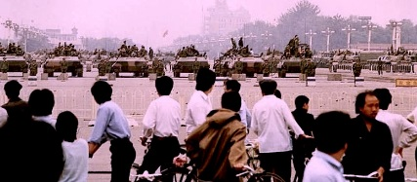
How and why did the Democracy Movement develop?
L/O – To identify the key features of the Democracy movement

Slide 2
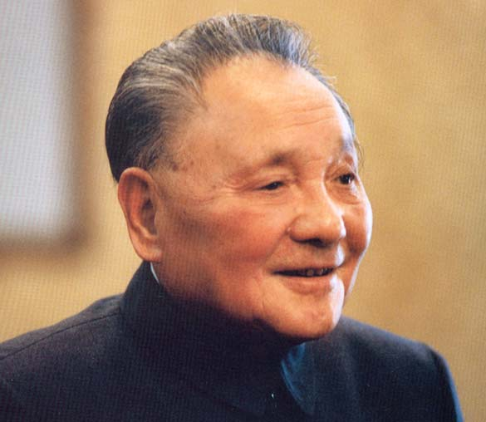
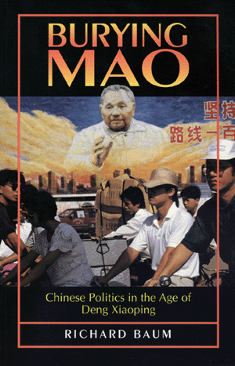
Deng’s opposition to Political Reforms
Although Deng believed in economic reform and Westernisation he was very conservative in his approach to political change.
He was influenced by what he called the ‘four cardinal principles’. These were:
Keeping the socialist road
Upholding the people’s democratic dictatorship
Upholding leadership by the Communist Party
Upholding Marxism-Leninism and Mao Zedong Thought
In other words, he wanted to maintain the dictatorship of the CCP. The CCP was entitled to expect the absolute obedience of the people.

Slide 3
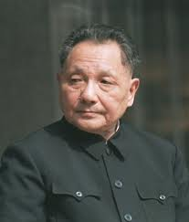
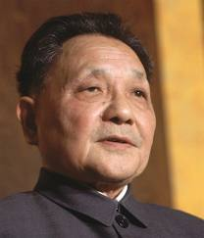
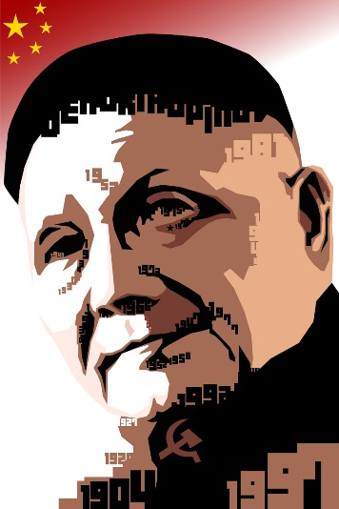
Political Policies
Deng was an economic reformer but a Communist hard liner. He believed China had gone through the bitter experience of the Cultural Revolution and needed a rest from political argument.
In the 1980 National People’s Congress this was expressed in a resolution which ‘condemned’ the view that people had a right to speak freely.
He also wanted to restore the authority and control of the CCP. He wanted to show that the CCP was still capable of governing China after the disasters of the GLF and Cultural Revolution.

Slide 4
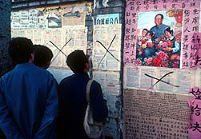
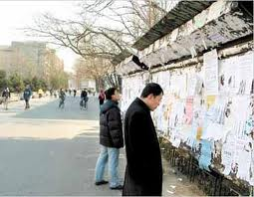
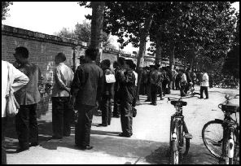
The ‘Democracy Wall’ Movement
In the late 1970s, some people demanded greater reforms and more democratic political system.
Led by students and young people, early in 1979 Wall posters began to appear in the Avenue of Eternal Peace, near Tiananmen Square on a 200 ft long brick wall.
The avenue was a common gathering place for students, who established the practice of affixing a mass of literature to the wall.

Slide 5
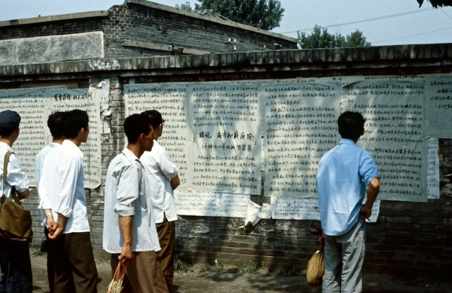
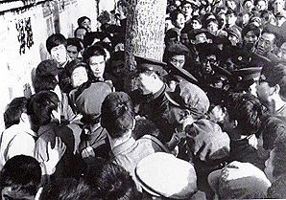
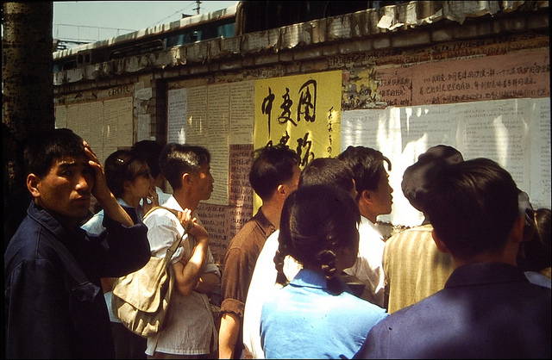
The ‘Democracy Wall’ Movement
Some posters were political graffiti. The writing covered every possible subject and gave students an opportunity to express anti-government and anti-Party feelings.
Every so often the government forbade the use of the wall and tore down the posters.
The greatest agitation came from those people who had suffered severely during the Cultural Revolution but who had not really benefited from Deng’s new policies.

Slide 6
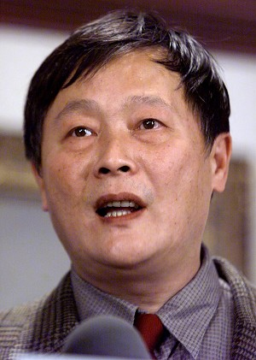
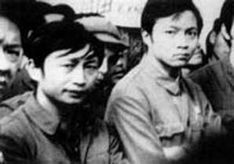
Wei Jingsheng
Wei Jingsheng had been arrested by Jiang Qing. He was an accomplished writer and, on March 25th 1979, published an article with the title ‘Democracy or New Dictatorship’ which made a strong attack on Deng.
He accused Deng of blaming the ‘Democracy Movement’ for the failures of his economic policies. This shocked Deng. In the summer of 1979 authorities cracked down on posters. Wei was arrested and brought to trial. He was sentenced to 15 years imprisonment.

Slide 7
The democracy movement
“Most of the participants were ex-Red Guards and workers, who might have been students but for the suspension of their education from 1966 to 1976. They used the methods and strategies they had learned in the Cultural Revolution forming unofficial groups, putting up large-character posters, writing and printing pamphlets, and setting up their own networks to achieve their own political goals”
(Goldman, 1999)
Wei was regarded as the first martyr of the ‘democracy movement’.
It was never an organised party but it represented those intellectuals who saw in Deng’s reforms the opportunity to modernise the political system as well as the economy.
The movement urged Deng to follow the principles of the CCP and commit himself to the rule of the people and the adoption of democracy.

Slide 8
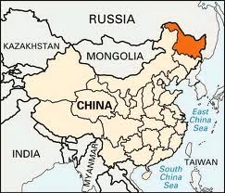
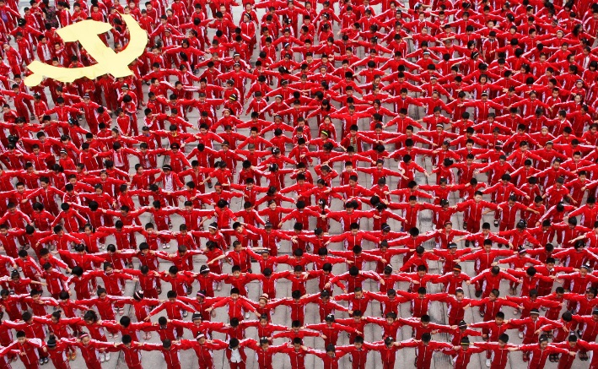
The democracy movement
It also accused the government of China of being corrupt. In late 1970s a notorious case of racketeering came to light in Heilongjiang province.
Managers of a state-owned fuel and power company had been pocketing large sums of public money. The culprits, who were all members of the CCP, were put on trial and executed.
It was a journalist who had revealed the corruption.

Slide 9
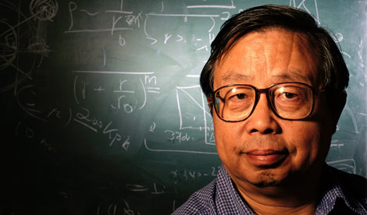
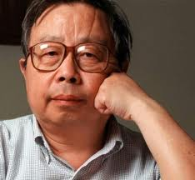
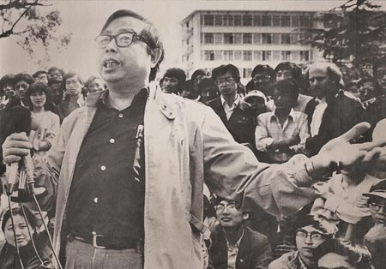
CCP Corruption
Many of the subsequent student demonstrations of the 1980s were due to the belief the CCP was corrupt.
In 1986 major disturbances occurred in universities in Hefei, Wuhan & Shanghai. Protesters followed Fang Lizhi who was a professor at Hefei and was demanding open government and democracy. Fang was arrested.
On 5th January 1987 students at Beijing University burnt copies of local CCP newspapers and carried posters through the streets opposing ‘conservatives and reactionaries’.

Slide 10
Deng’s Reaction
Deng tolerated the democracy movement at first, only turning on it when he was directly challenged, such as the attacks by Wei Jingsheng.
After crushing the 1986 University demonstrations Deng insisted that genuine democracy was not an option for China.
He insisted that there was no need for greater participation by the people in the politics of China - Uninformed people should be content to let their enlightened government lead them.

Slide 11
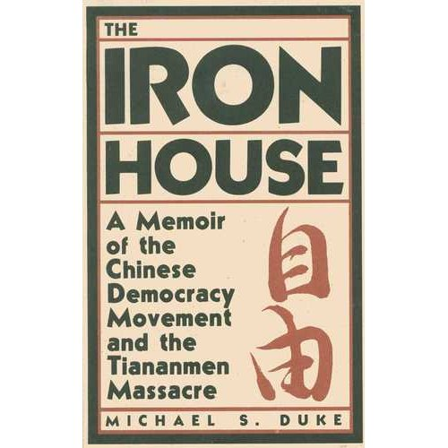
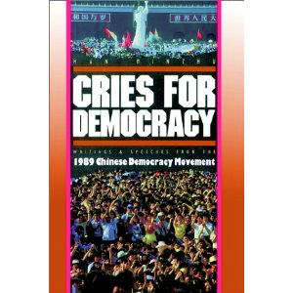
Growing Opposition and Unrest
Deng faced increasing opposition in the mid and later 1980s:
The Democracy Movement was disappointed at his rejection of democracy and repression of student meetings.
Economic reforms disappointed many – downturn in industrial and agricultural production + inflation = reduced workers’ real wages.
Students felt the CCP had failed to deliver progress and reform.
Disappointment at lack of job opportunities.

Slide 12
Exam Question
“Describe the key features of the Democracy Movement of 1979-1989.”
(7 marks)
Make a link or links between the key features.
Use connective words: this led to, as a result, moreover, furthermore, as a consequence, in addition.
First Reason | Give the feature. Fully explain it.
Link | Make a link with the second feature. this led to, as a result, moreover, in addition…
Second Reason | Give the feature. Fully explain it.
Conclusion | Sum up the two features stressing the links between them.

Slide 13
Question B – Mark Scheme
Level | Descriptor | Mark
Level 1 | Simple or generalised statements or key features Statements lack any supporting contextual knowledge or makes generalisations e.g. Tried to introduced free speech | 1-2 1 mark for one simple statement 2 marks for two or more
Level 2 | Developed Statements of key features Supports their statement with relevant contextual knowledge e.g. Mao tried to introduce free speech in order to direct criticism at the government and his rivals who he disagreed with. He worried about a growing middle class. | 3-5 3 marks for one developed statement 4-5 marks for two or more
Level 3 | Developed exposition of key features An exposition of more than one factor supported by selected knowledge. e.g. Mao tried to introduce free speech as a way of directing criticism at his rivals in government like Zhou Enlai who he disagreed with about the future of economic development after the 1st Five Year Plan. Zhou favoured planned growth led by government whilst Mao wanted growth to come from the mass mobilisation of the peasants because… | 6-7 6 marks for two or more factors 7 marks for answers which show links between factors

