Slide 1
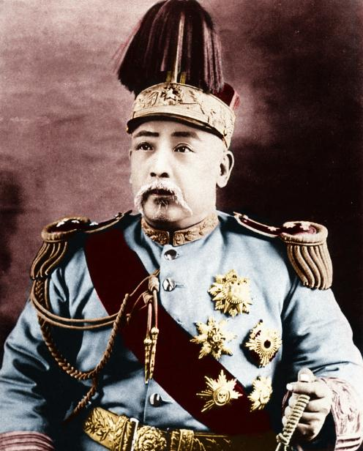
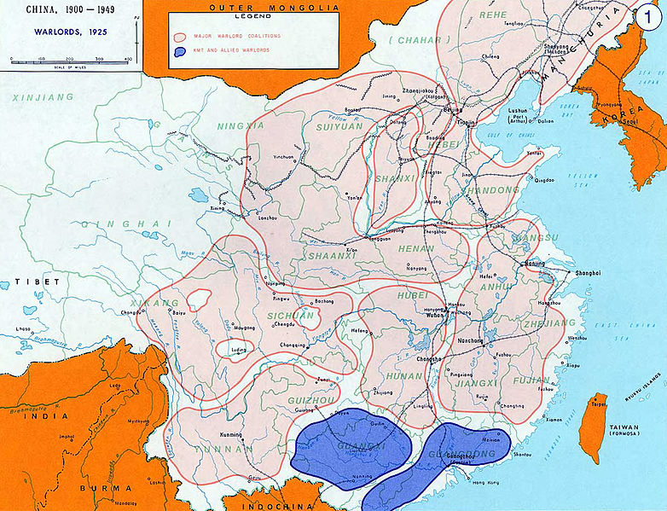
How did China change during the warlord period?
L/O – To understand the changes in China between 1911-1927

Slide 2
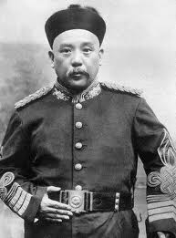
After the Revolution
In 1912, Yuan Shikai became the President of the Chinese Republic. He was the leader of the Beiyang Army, the best fighting force in China. Its commanders all owed him loyalty.
Sun Yat-Sen had no choice but to surrender the Presidency to him. They hoped he would rule as a constitutional president with a parliament modelled on the US Congress.

Slide 3
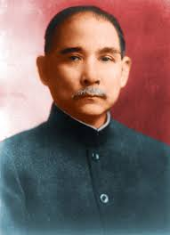
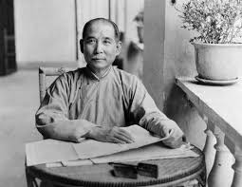
December 1912 Elections
There was to be a senate elected by the different provincial assemblies and a house of representatives.
Four main political parties emerged in China with over 300 local parties. The National People’s Party (GMD/KMT) was created by Sun Yat-sen.
The KMT won 43% vote and 259/596 seats.

Slide 4
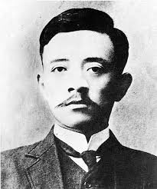
Yuan Shikai takes over
The KMT expected to form a new government and they appointed Song Jiaoren as prime minister.
He was assassinated on 20th March 1913 as he was about to board a train to Beijing.
In May, KMT military governors were dismissed and Nanjing was occupied by Yuan Shikai’s troops. The new assembly was forced to elect Yuan as president for five years and the KMT was banned!

Slide 5
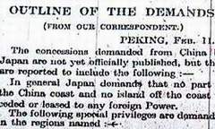
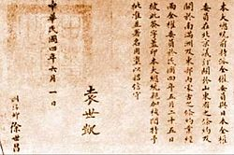
The Twenty-One Demands
Yuan had become leader of a China facing serious problems. The regime he led relied on foreign loans. Tax income was declining.
Luckily, WW1 had distracted many foreign governments but Japan took advantage of China’s weakness and in January 1915, presented the 21 Demands.
Yuan was forced to sign these demands, further undermining his authority.

Slide 6
The 21-Demands – January 1915
Group 1 – Japan to have control of Shandong Province and its economy
Group 2 – Japan to be given economic influence over Manchuria and East Mongolia, including all railways and the city of Port Arthur (Lushan).
Group 3 – Japan to be given control over the Hanyeping Mining Complex
Group 4 – China is not permitted to cede land to any foreign power apart from Japan
Group 5 – Japan to be given influence over all important political, military and financial decisions, Japanese workers to be employed in the Chinese Police Force

Slide 7
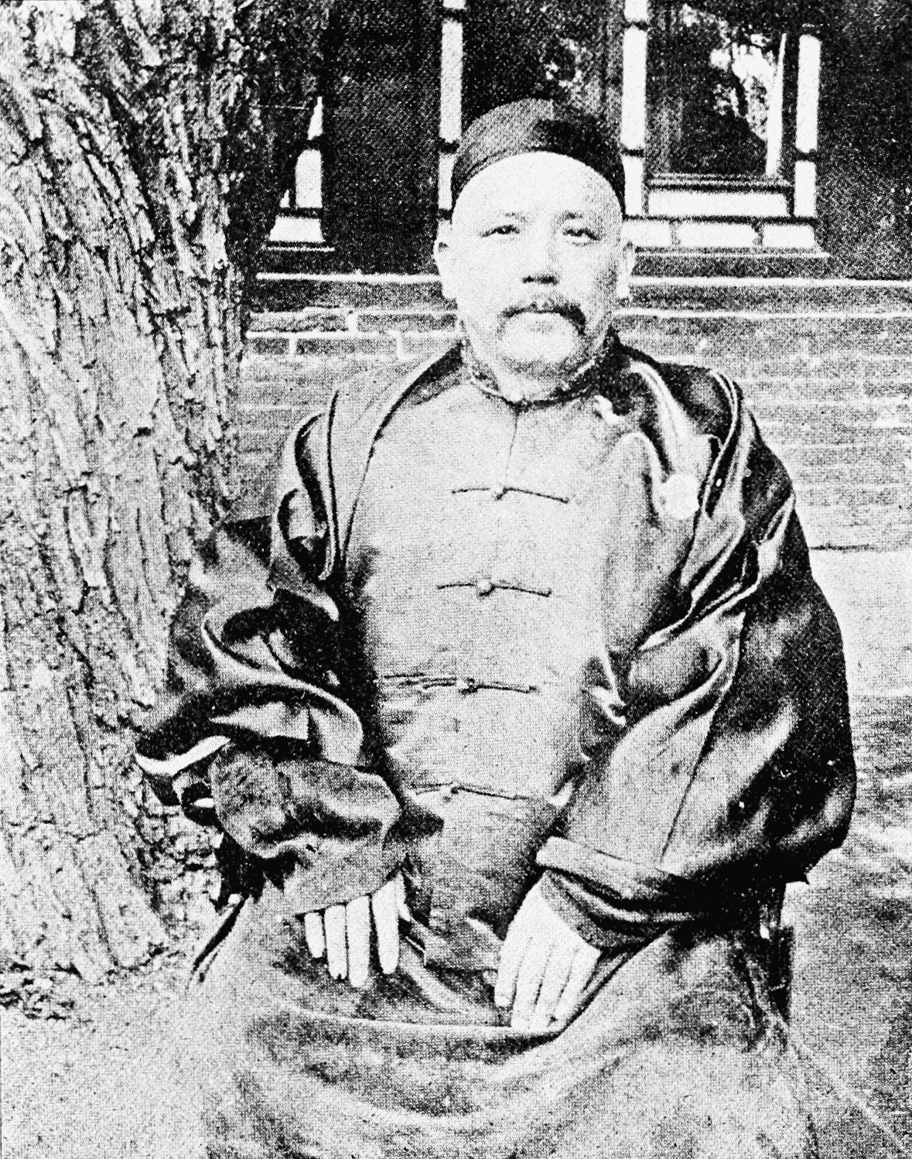
The Twenty-One Demands
Despite this humiliation by the Japanese, Yuan pressed ahead with his plans. He declared himself emperor of China but this just triggered revolts. Yunnan declared independence.
Yuan reluctantly back-peddled and dropped the plans in March 1916. In June, he died aged 56. He was replaced by the vice president but in July 1917, he fell victim to a coup by Yuan’s commanders. The era of the warlords had begun.

Slide 8
Reasons for the failure of Yuan Shikai
Provincialism of the Gentry - Local gentry feared that a restored monarchy would successful centralise power again, harming their own interests and independence.
Military Followers – Yuan’s generals made use of him to gain power for themselves in their local areas. Restoring the monarchy threatened their newly won power.
Strength of Republicanism – The idea of a republic had become embedded amongst intellectuals. Restoring the monarchy was seen as a backward step.
21-Demands – By accepting the 21-Demands, Yuan’s popularity and credibility was serious damaged.

Slide 9
Legacy of Yuan’s Rule
After Yuan’s death, the old parliament was re-established in August 1916, and the original 1912 constitution was followed again.
Some intellectuals became disillusioned with republicanism and monarchy, turning to new ideas like communism.
However Yuan had significantly weakened the power of the central government. China was divided. His old generals who he relied upon to rule, began to dominate the provinces, ignoring Beijing. This led to the warlord period until 1927.
Social and economic reforms had been neglected by Yuan, which weakened China and encouraged more aggressive demands from Japan.

Slide 10
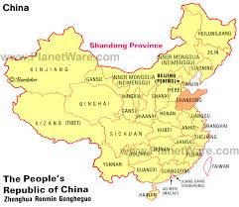
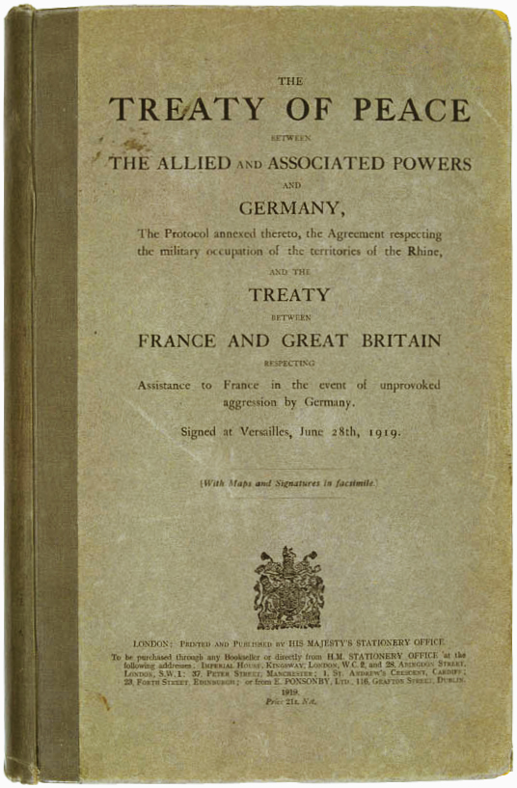
Era of the Warlords
China now descended into anarchy. In 1917, China declared war on Germany, hoping to gain control of German concessions in Shandong province.
This was not to be. In the Treaty of Versailles, Japan was given control of the German concessions, not China.
This fresh humiliation sparked off the 4th May demonstrations.

Slide 11
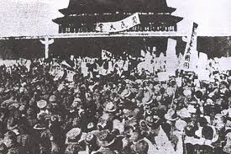
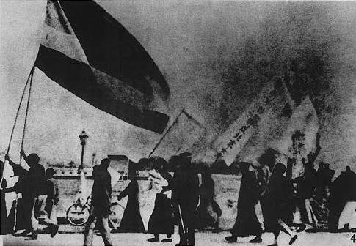
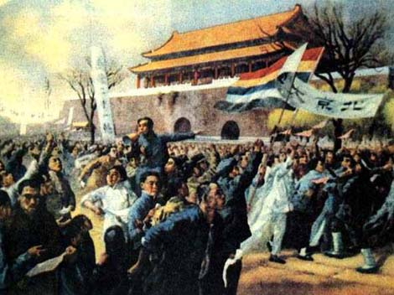
May 4th Movement
An explosive protest from the students of Beijing university took place in Tiananmen Square. 3000 students from 13 colleges assembled.
They protested at the humiliation of China and demanded their government confront Japan.
A student union was established – the May 4th movement. This was replicated across China. A general strike was held which prevented the Chinese delegation from signing the treaty.

Slide 12
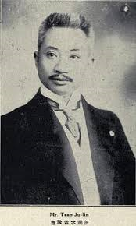
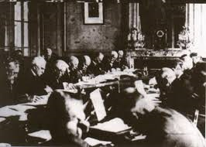
The May 4th Demonstrations (五四运动)
The government was shocked. Under pressure and facing economic collapse, it dismissed the pro-Japanese members of government including – Cao Rulin (曹汝霖) who had signed the 21-Demands.
It instructed the delegation in Paris to make its own decision – it eventually refused to sign the peace treaty.
The May 4th Demonstrations served as a ‘catalyst’ for the intellectual revolution, intensifying debate and leading to a split in the movement.
Cao Rulin

Slide 13
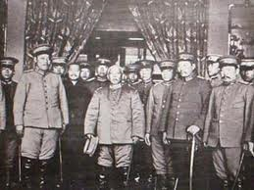
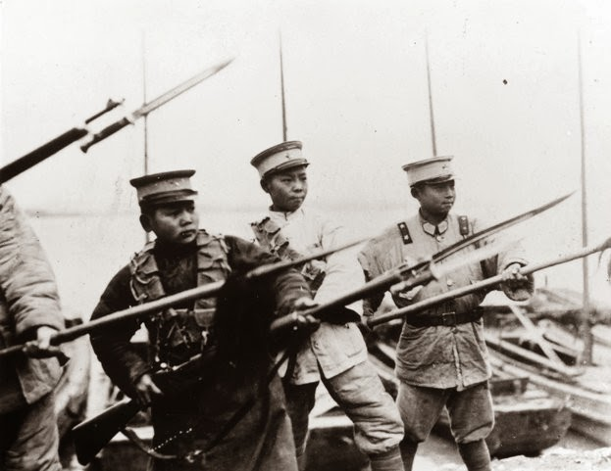
The Warlord Period
Despite the 4th May protests movement by young students, most people in China faced tragic consequences as Yuan Shikai’s generals vied with one another for control of a particular region.
They also fought for the ultimate prize – control of Beijing and the central government that in theory still functioned there.

Slide 14
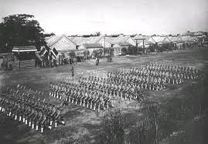
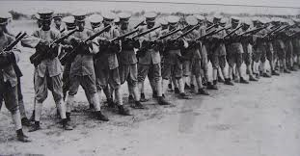
The Warlord Period
Between 1920-1926, competing groups of warlords fought battles all over China. They all needed money to do this. Troops needed feeding and paying.
Everything was taxed and cash squeezed from a suffering peasantry. Many warlords just printed money – resulting in severe inflation. Money lost its value.

Slide 16
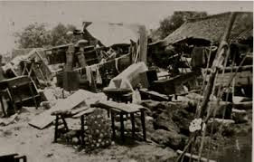
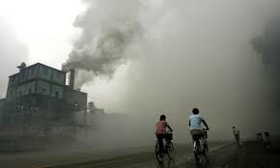
The Warlord Period
To make matters worse, there was a drought in northern China in 1918 and famines in 1920-21. 1923-25 also saw more flooding.
However there was a growth in industry at this time – WW1 meant European products couldn’t get to China – giving China’s producers an open market.

Slide 17
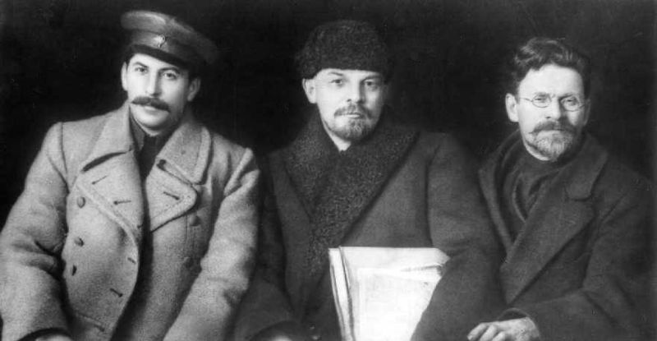
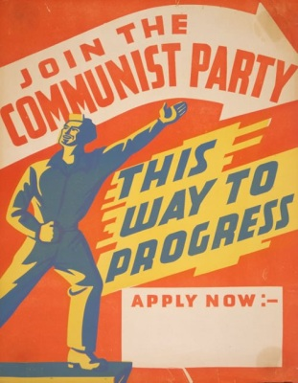
The Chinese Communist Party (CCP)
Two groups came together in the 1920s to defeat the warlords. One was the CCP.
Many Chinese revolutionaries looked to Russia for support. In 1917, the Bolsheviks had taken control in Russia and offered to give back all areas of China back to the Chinese.
Communism seemed to offer a solution to the warlord problem.

Slide 18
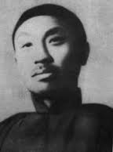
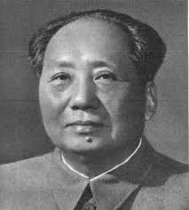
The Chinese Communist Party (CCP)
Revolutionaries like Chen Duxui, leader of the 4th May Movement, increasingly became interested in Marxism.
Small Marxists study groups were founded in Shanghai and Beijing. Mao Zedong founded a group in Changsha.
Numbers were small but the USSR sent COMINTERN agents to help support these groups.

Slide 19
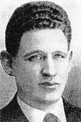
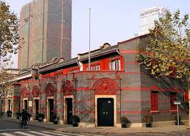
The Chinese Communist Party (CCP)
Agent Gregory Voitinski made contact with Chen Duxui in May 1920. A translation of the Communist Manifesto was arranged.
The founding congress of the party was held in a classroom at a girls school in the French concession of Shanghai, July 1921. Mao Zedong was one of the delegates but Chen Duxui was elected secretary general.

Slide 20
The Chinese Communist Party (CCP)
The COMINTERN provided $5000 USD a year to keep the party alive. However there were constant disagreement over whether to work with the GMD or not.
The USSR wanted the CCP to work with the GMD, who they viewed as the stronger party.
In the 1922 congress of the CCP it was agreed to seek an alliance with the GMD to fight the warlords. In the third congress of 1923, they actually agreed to let communists join the GMD.

Slide 21
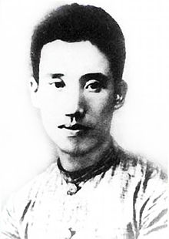
The Chinese Communist Party (CCP)
Mao joined the GMD as well in 1923 and won membership of the central committee. From 1923-26 he worked with the United Front as a GMD official.
He did not get on with the CCP leadership circle around Chen Duxui. He disliked their intellectualism and their focus on city workers.
In 1925, he was excluded from the central committee and was attracted to the ideas of Peng Pai, who he joined at a training institute for rural militants.

Slide 22
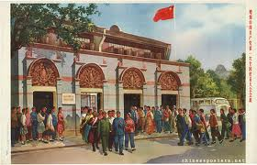
The Chinese Communist Party (CCP)
Despite the low expectations of the USSR, the CCP expanded rapidly from 200 members in 1922 to 7000 in 1926 and 30,000 by the end of that year.
By 1927, membership reached about 58,000 making it the 3rd largest communist party in the world and a major force in China.
The GMD slowly became concerned with this growth, despite their alliance.

Slide 23
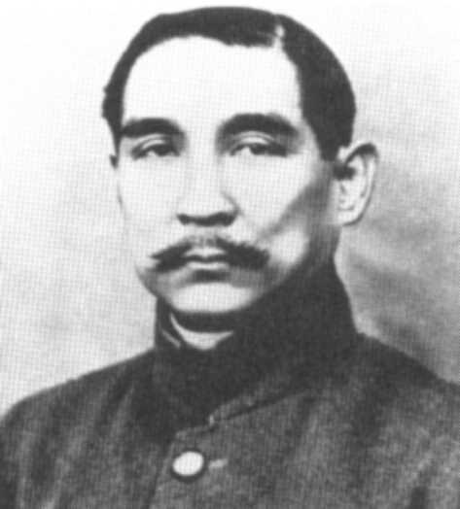
The Kuomintang (KMT/GMD)
The 3 Principles of the Kuomintang
1.) Nationalism: to rid China of foreign influence and exploitation
2.) Democracy: to create a more modern system of government acceptable to the people of China
3.) Social Advance: to bring about reforms in industry and everyday life and particularly to improve the position of Chinese peasants
This was the People’s National Party and was formed to unite China.
It was set up by Sun Yat-sen and was based on his 3 principles.
He was determined to rid China of foreign influence and to remove the power of the warlords.

Slide 24
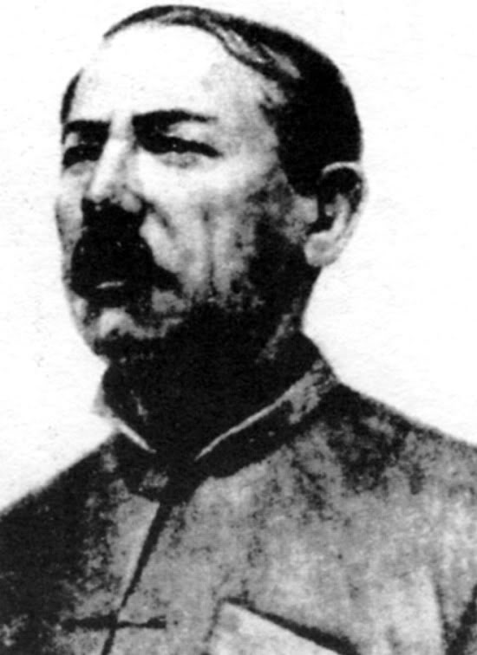
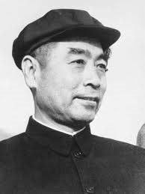
The Kuomintang
The USSR made contact with the KMT in January 1923 through their representative, Mikhail Borodin. Borodin helped Sun Yat-sen to reform the KMT.
Sun realised that he would need an army to deal with the warlords and regain China. The USSR offered the KMT money and advisors to support a new military academy at Canton.
The Whampoa Military Academy was founded by the USSR with Chiang Kai-Shek as it commandant and Zhou Enlai as its poltical commissar.

Slide 25
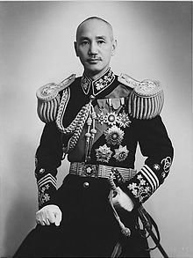
Sun Yat-sen Dies…
In 1925 Sun Yat-sen died of cancer. Chiang Kai-Shek, who was the leader of the KMT army, became leader.
Chiang K-S was alarmed at the growing power of the CCP. Most KMT officers were landlords or came from the business classes. They were afraid of the Communists.

Slide 26
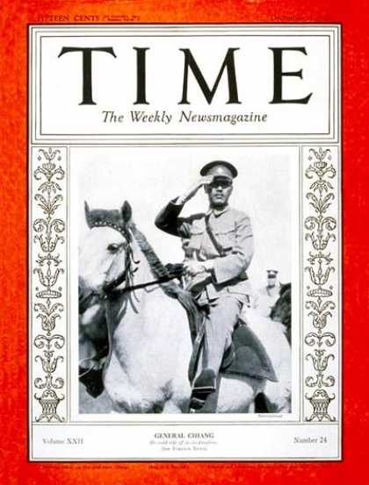
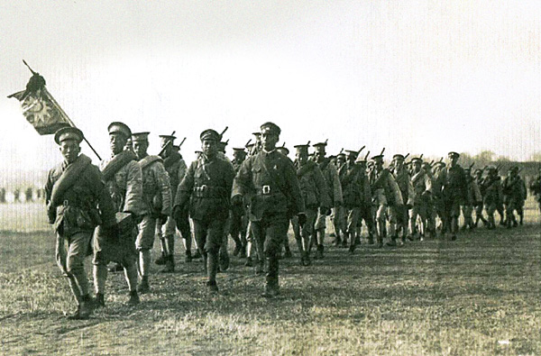
The Northern Expedition 1926-1928
The attack on the warlords began in 1926, in a combined operation amongst the KMT and CCP.
Peasants & workers welcomed Chiang’s armies & there was little resistance from the warlords.
China was now reunified and Chiang’s government was recognised by foreign powers.

Slide 27
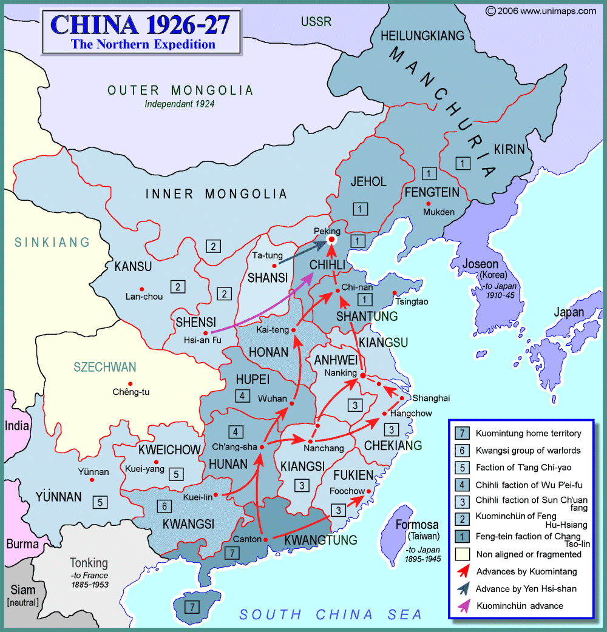

Slide 28
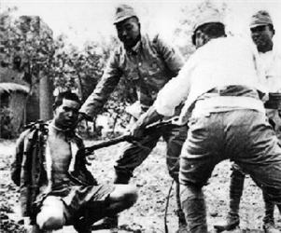
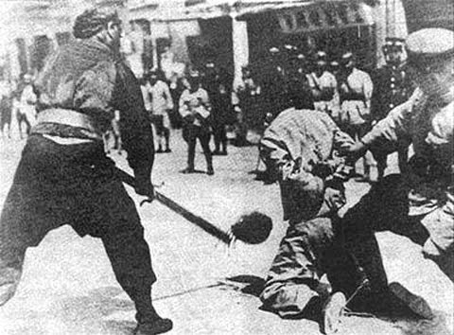
The Shanghai Massacres - 1927
Chiang feared the growing influence of the CCP, especially in Shanghai.
In 1927 he turned on them & the KMT sent an army to Shanghai. The workers of Shanghai rebelled against the warlord in the area.
When Chiang’s army arrived, it executed all the Communists it could find.

Slide 29
Summary Questions
Why did the control of the government in Beijing over the provinces of China break down in the years 1912-26?
What explains the success of the Northern Expedition of 1926?
In what ways did the USSR influence political developments in China in the period 1921-27?
Why did the United Front come to an end in 1927?

