Slide 1
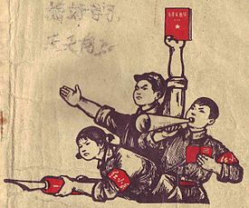
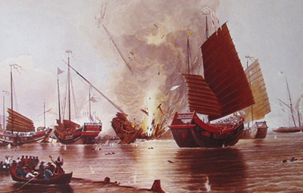
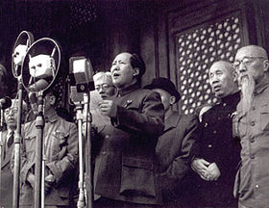
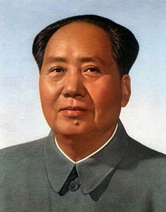
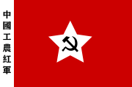
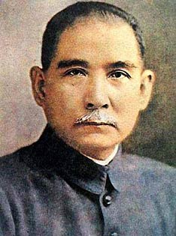
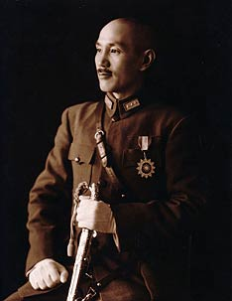
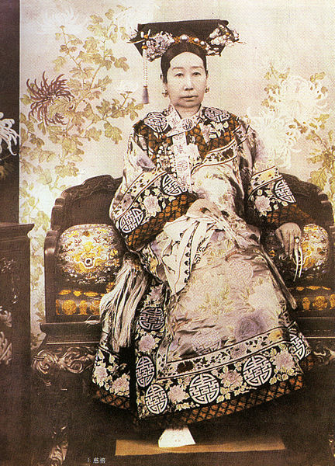
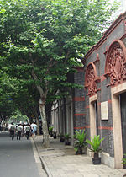
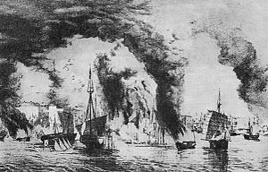
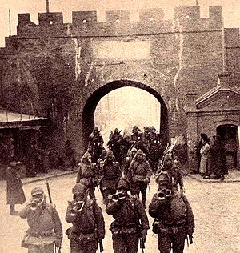
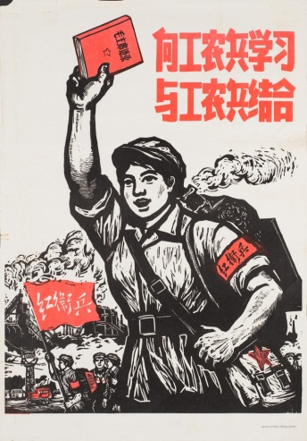
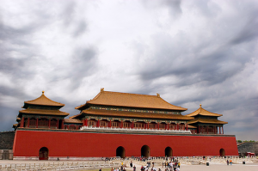
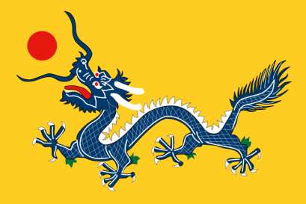
The Founding of the People’s Republic of China
Understanding Imperial China

Slide 2
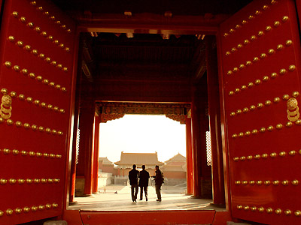
Key Terms

Slide 3
China- The Middle Kingdom
中國
What does it mean?
What does it say about how China viewed itself and the world?

Slide 4
The Mandate of Heaven
The idea that the emperor had divine right to rule. The emperor had supreme authority because he was especially chosen by heaven.
In turn this meant that anyone who could successfully overthrow an emperor would be seen as legitimate as emperors could only ever be on the throne with the express permission of heaven.

Slide 5
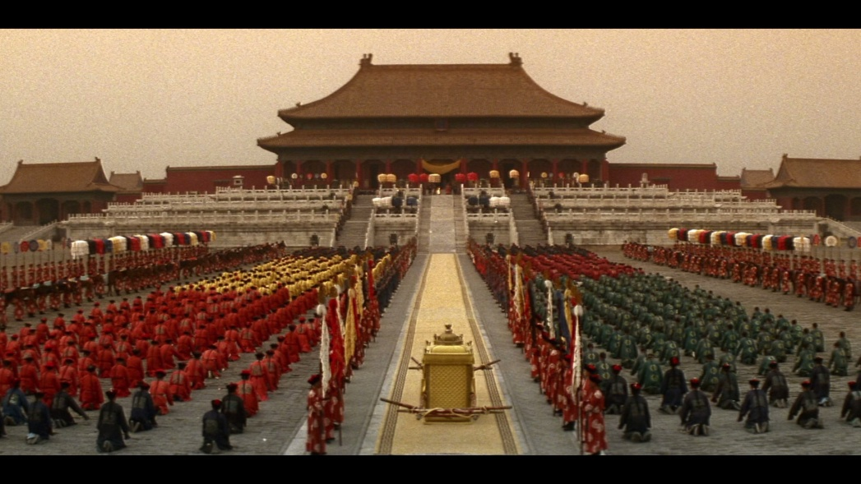
Dynasty
Royal houses that ruled China with their own specific characteristics. Names for each dynasty were often chosen for superstitious or poetic reasons, unlike in Europe where dynasty names followed the house’s family name.

Slide 6
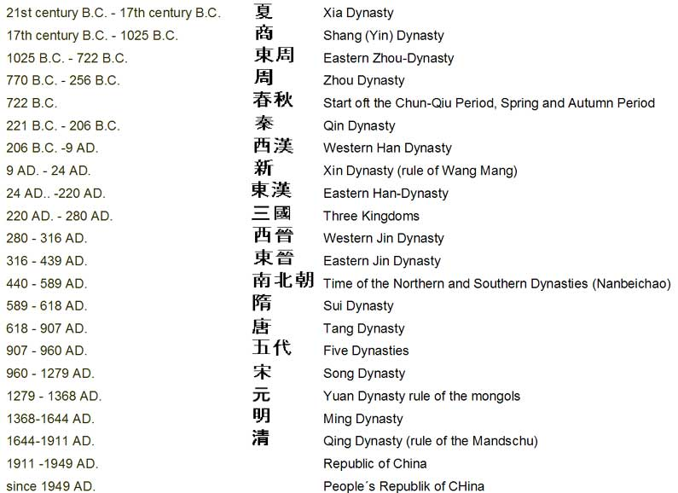

Slide 7
Ming Dynasty
1368-1644
Han ethnicity
The Ming came to power after organising an armed resistance against the Mongolian Yuan dynasty set up after the conquests of Genghis Khan
Created an era of stability and relative peace throughout China and introduced strong infrastructures that lasted until the fall of the Qing

Slide 8
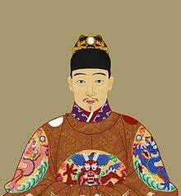
Ming Dynasty
Considered by European visitors as civilised and culturally and technologically advanced
The Ming’s mandate of heaven came to an end with a series of disasters and political failures which incited rebellion
Chongzhen, the last Ming emperor

Slide 9
Ming Dynasty
The last emperor, Chongzhen, committed suicide by hanging when he recognised his mandate was over and left this suicide note:
I am insufficient in virtues and weak in conducts, hence the heavenly punishment, and the ministers also failed me. Having no dignity to face my ancestors, I would undress my crown and cover my face with hair. Mutilate my body as you wish, but do not harm a single civilian.
This death was met by hundreds more suicides by servants and officials loyal to the emperor.

Slide 10
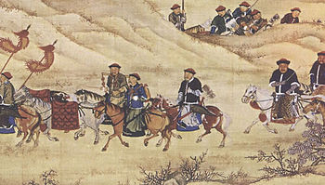
Qing Dynasty
The Manchurians in the North East of China (東北) crossed the Great Wall with the intention of ‘defending the Ming’ and defeating the rebellion
Soon after the Qing dynasty was founded which was soon to greatly
change the face of China

Slide 11
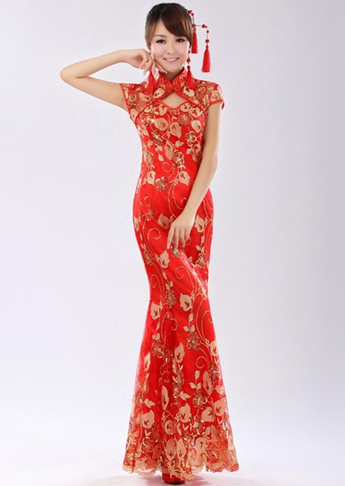
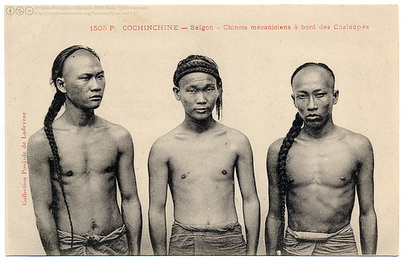
Qing changes:
Border expansion
National dress
Mandatory queue for men
Influence on Mandarin (儿化音)

Slide 12
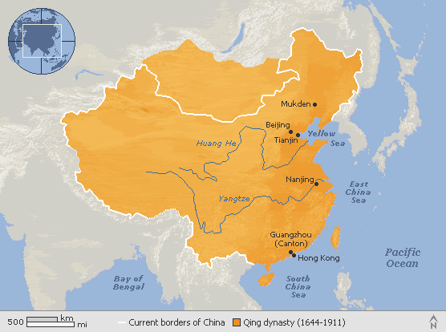

Slide 13
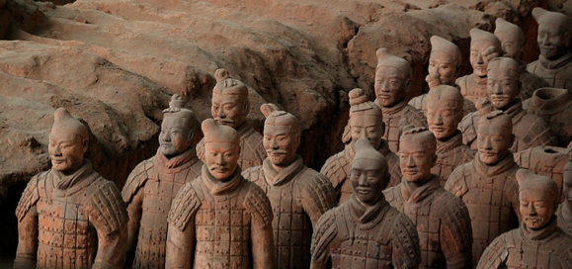
Han
China’s largest ethnic group
Creators of classical China
汉语

Slide 14
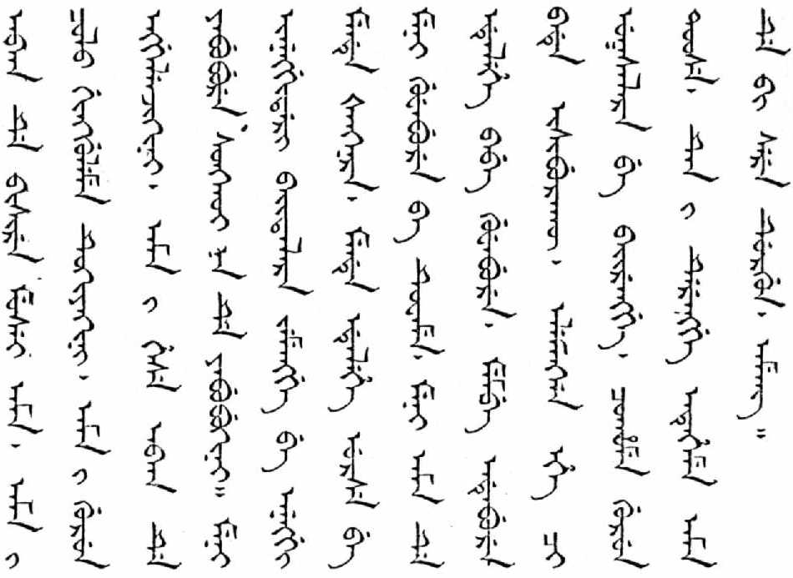
Manchu
From modern 东北
Culturally different from the Han
Due to immigration the Manchus have practically disappeared from modern China, only a few people can
speak the Manchu
language

Slide 15
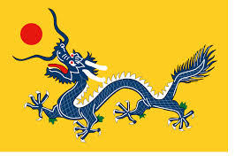
Part 1: The Rule of the Qing

Slide 16
Stable and secure
Organised society on a feudal system
Developed legal system
Vietnam, Cambodia, Thailand and Korea as vassal states
Conservative and Confucian
Isolationist (China was still the Middle Kingdom)
Inter-race marriage forbidden

Slide 17
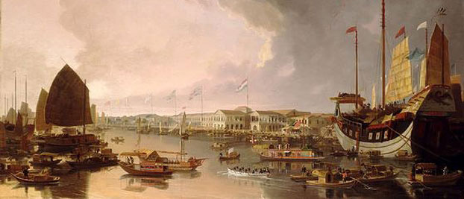
Contact with the West
Traditionalists looked down on Western technology and science
Trade was heavily restricted to one season a year and only in Canton (Canton system)
Did not want Western goods- something that began to anger the West….

Slide 18
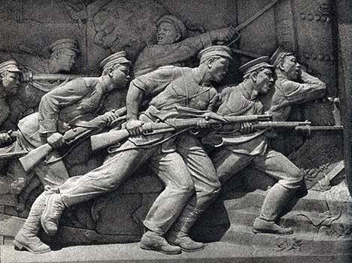
Part 2: The Fall of the Qing

Slide 19
Opium and Malcontent
Opium trade caused friction between China and the West (especially Britain and France)
Opium wars weakened Qing legitimacy and control over China
Mass rebellions
Economic and political disasters in hindering reform throughout the end of the 19th century

Slide 20
Cixi
Dowager empress of China
Controversial figure- feudal despot or modern political genius?
Dealt with Japanese sabotage and difficult Westerners
Came to represent all that was wrong with the imperial system in the years after her death but was seen as an ingenious politician during her lifetime

Slide 21
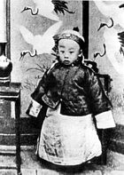
Puyi
Last emperor of China (r. 1908-1912)
Rightful emperor recently killed (allegedly) by Cixi before her own death in order to hinder Japanese influence over the country
China ruled by regents who attempted to maintain the dynasty and keep peace within an ever turbulent China

Slide 22
The Empire Crumbles
China was being attacked politically and economically by the West and Japan (especially Japan)
Han dominated China started to lose faith in the Qing and wanted a modern political system in order to regain China’s former prestige
Various uprisings and protests destroyed Qing legitimacy and ability to rule

Slide 23
Sun Yat Sen
An educated Chinese revolutionary who had been educated abroad
Advocated the founding of a republic
Galvanised overseas Chinese and foreign sympathies in order to create an effective opposition to the Qing
Founded the National Party of China
Stepped into the breach after the fall of the Qing
Allowed Yuan Shikai to take Presidency in order to ensure the founding of China’s first republic

Slide 24
Armed Rebellion
Growing discontent, spurred on by economic, political and local factors (as well as being influenced by Sun Yat Sen) resulted in armed rebellions against local Qing governments
A weak Qing army meant that continual armed rebellions could not be stopped
Province after province began to declare independence

Slide 25
Xinhai Revolution
October 1911- February 1912
Name for the continuous armed rebellions against the Qing
Brief civil war
Manchu military leader Yuan Shikai and revolutionary Sun Yat Sen agreed a compromise and Yuan became China’s first president but effectively ruled as an emperor
Sun Yat Sen finally takes power after Yuan’s death in 1916

Slide 26
Timeline of Key Events

Slide 27
1644-1911The Qing Dynasty
1792Novel, The Dream of the Red Chamber, published
1793Macartney Mission from Great Britain
1839-1842Opium War between Great Britain and China
1842-1843Treaty of Nanking and Bogue Supplement fix tariff at 5 percent and establish extraterritoriality and most-favoured-nation principle in China. Great Britain acquires Hong Kong.
1850-1864 Taiping Rebellion
1860 Treaty of Peking; Great Britain acquires Kowloon; Russia gets all lands north of Amur and east of Ussuri Rivers.

Slide 28
1884-1885China defeated in war with France; establishment of French Indo-China
1894-1895China defeated by Japan; treaty of Shimonoseki
1895-1900 Scramble for concessions
1898 Hundred Day's Reform attempted by the Guangxu Emperor on advice of Kang Youwei (1823-1901); halted by Empress Dowager Cixi
1900-1901Boxer Rebellion; allied occupation of Peking; indemnity of 450 million taels (Chinese silver coins)
1905Abolition of the civil service examination system. Sun Yat-sen (1866-1925) founds Revolutionary Alliance in Tokyo.
1912China declared a republic; Sun Yat-sen first President, but resigns in favour of Yuan Shihkai (1859-1916); formation of Nationalist Party
Source: http://afe.easia.columbia.edu/timelines/china_modern_timeline.htm#timeline

Slide 30
Questions for Further Study
Why do you think the imperial system lasted for so long?
What are the key differences between the modern Chinese political system and the imperial political system?
Critique the imperial system of governance. What worked well? What were the key problems? Why did it fail? How could it have survived longer?

